Slide 1
Hygiene Heroes!
Be SUPER!

Slide 2
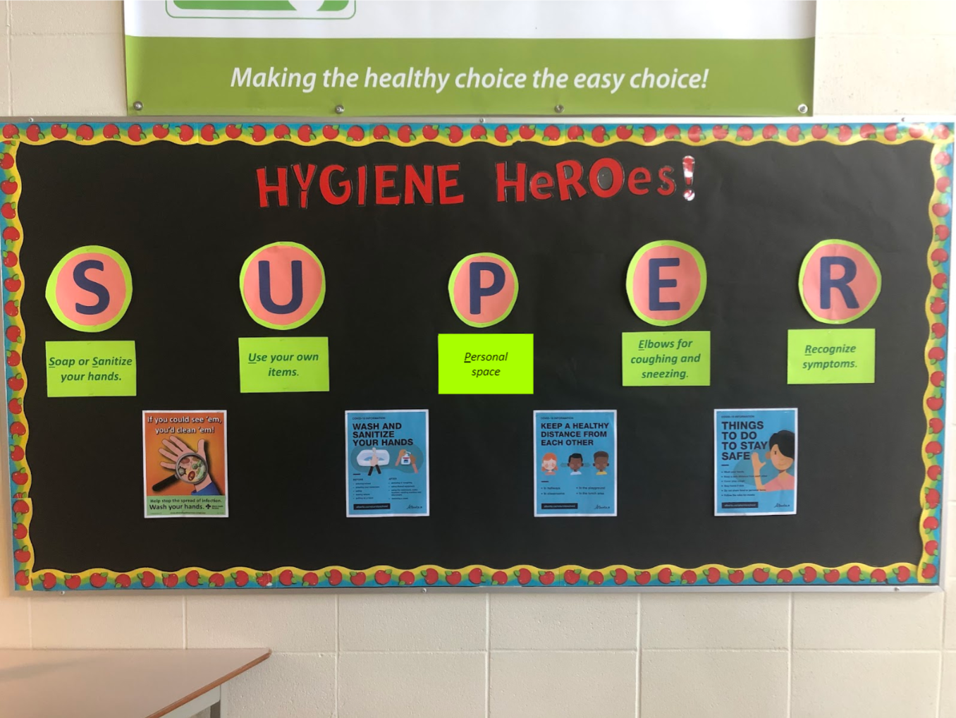
YOU are a Hygiene SUPER Hero!
Notes:
YOU can be a SUPERHero by helping protect yourself and others. We all have a part to play in keeping this school safe and clean. Here are some tips on how to be SUPER!

Slide 3
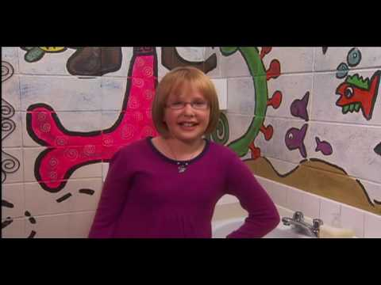
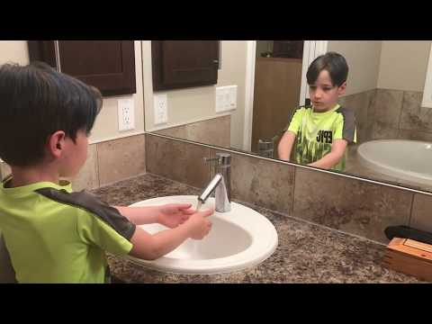
SOAP or SANITIZE your hands
S
Video obtained from http://www.dobugsneeddrugs.org/educational-resources/handwashing-videos/
Notes:
S is for soap or sanitize your hand. Properly washing your hands is a great way to help protect yourself and others from germs. Make sure you try to get every nook and cranny of your hands when you’re washing them. Don’t forget that you should be washing your hands for at least 20 seconds!
Please choose a video that works best for your school. The first video does not mention COVID-19, the second one does.

Slide 4
USE your own items
U
Notes:
U is for use your own items. Germs can live on surfaces like pencils, water bottles, books and erasers for a long time! If we’re trying to stop the spread of germs, let’s make sure we only use our own items whenever possible. And if we touch things that other people have touched, then remember ‘S,’ soap or sanitize your hands!

Slide 5
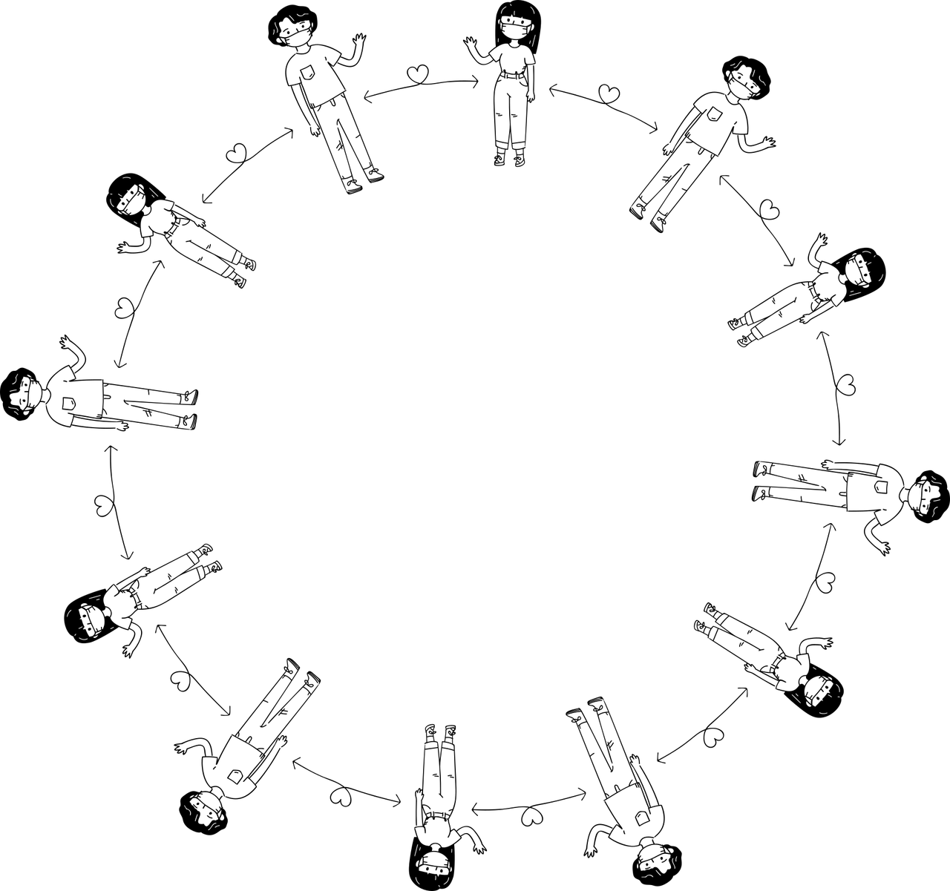
PERSONAL Space
P
Notes:
P is for personal space. Personal space means keeping a comfortable distance between yourself and the people around you. Do your best to have enough space that if you and the people around you were to stretch your arms out, you wouldn’t be able to touch hands. It is generally nice to allow this distance between yourself and others unless they say you can come closer, so that they don’t feel like you are getting too close!

Slide 6
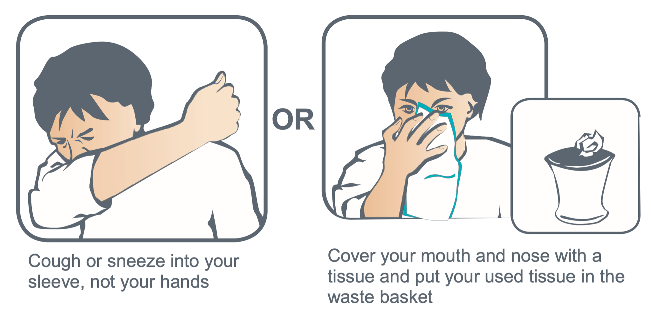
ELBOWS for coughing or sneezing
E
Image: https://www.albertahealthservices.ca/assets/healthinfo/ipc/if-hp-ipc-cover-cough.pdf
Notes:
E is for elbows for coughing and sneezing. When we cough or sneeze, we can spray droplets from our mouths that go into the air and can land on surfaces or other people. If we’re sick and those droplets come into contact with others, we might get them sick too! Let’s keep everyone safe by coughing and sneezing into our elbows.

Slide 7
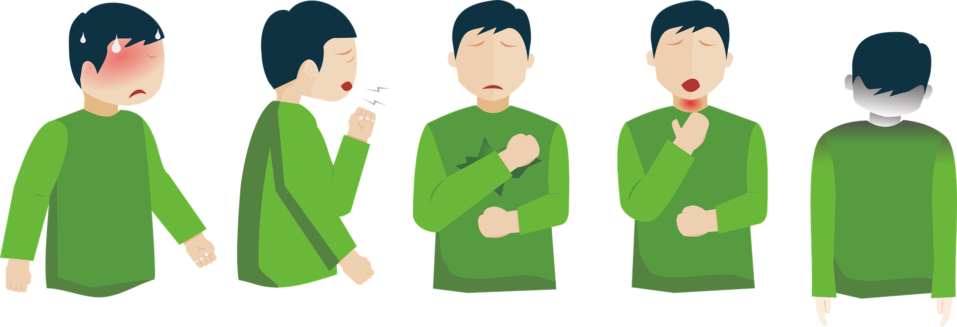
RECOGNIZE symptoms
R
Notes:
R is for recognize symptoms. Our bodies have ways of letting us know that we’re sick or getting sick. Some common ways our body warns us are fever, cough, shortness of breath or difficulty breathing, runny nose, and sore throat. If you think you might be sick, let someone in your family know!

Slide 8
Activity
1. Younger students - Using the drawing template (included in the bulletin board document), ask students to draw their own creation of a hygiene hero. What is their hero’s name? What do they look like? What are their special powers? Or what tools do they use to be a SUPER hygiene hero?
2. Older students - Using the writing template (included in the bulletin board document), ask students to write a short story on their creation for a hygiene hero, integrating the SUPER practices for reducing exposure the cold or flu bug. For example, students can create their hero’s backstory, how they got their SUPER powers, and how they got the name they did.
Notes:
Discuss COVID- 19 and viruses
http://www.appleschools.ca/files/Hygiene_SUPER_Heroes_Bulletin_Board.pdf Link for ready to use bulletin board and activity sheets

Slide 9
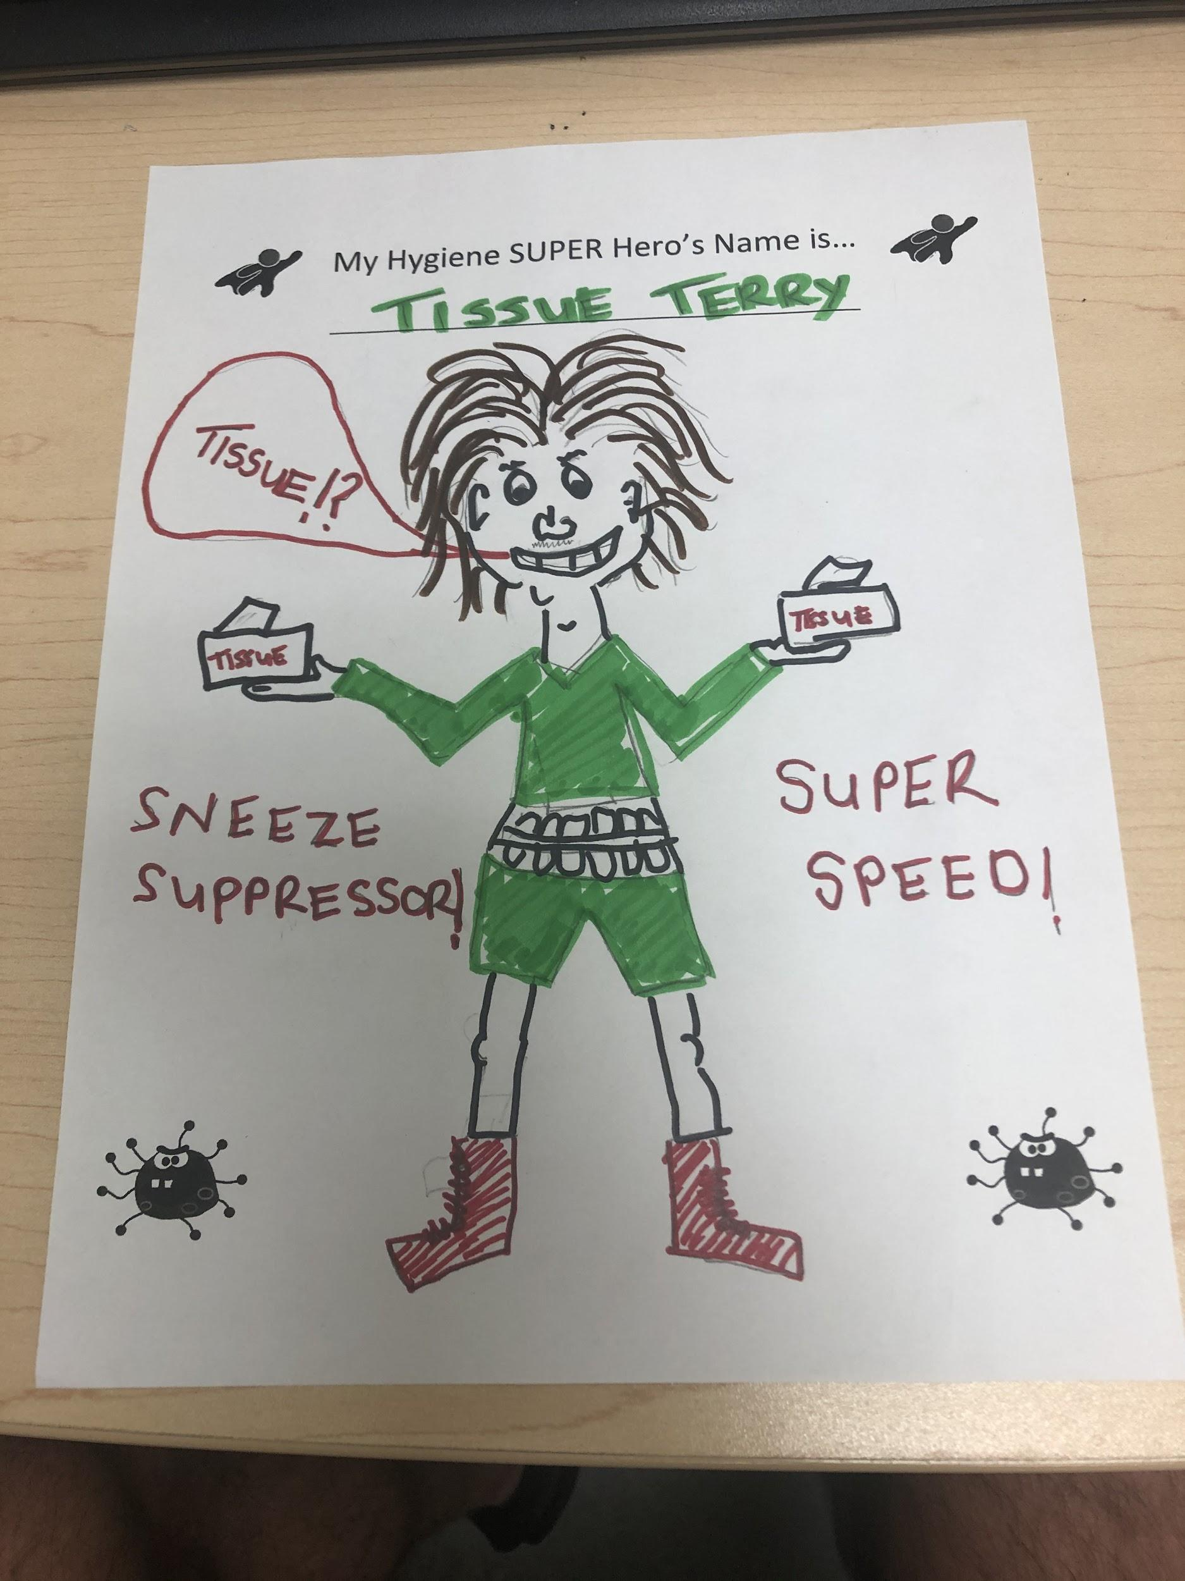
TISSUE TERRY
Notes:
Discuss COVID- 19 and viruses

