Slide 1
Way To Go H2O!!

Slide 2
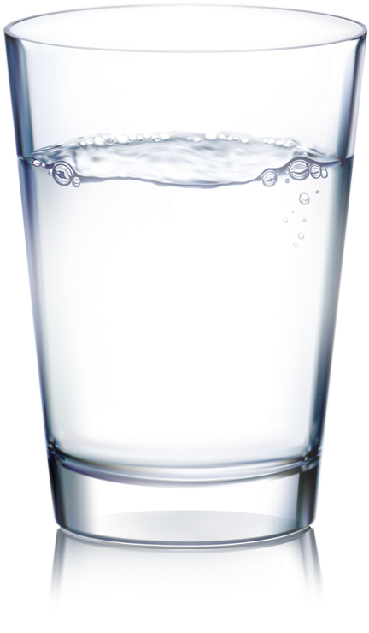
Why Do We Need Water?
Your body uses water in all its cells, organs, and tissues. Water helps to regulate body temperature and maintain other bodily functions. Since your body loses water each day, it's important to rehydrate by drinking fluids and eating foods that contain water.

Slide 3
Quiz Time!
What percentage of the human body is made up of water?

Slide 4
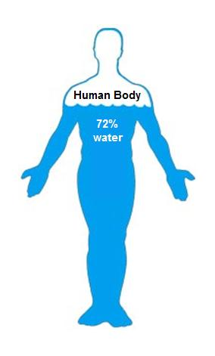
ANSWER:
60% - 70%

Slide 5
What does water do for my body?
Water keeps every part of your body working properly:
Moves nutrients and waste through your body.
Keeps your blood pumping normally.
Protects and cushions your joints and organs.
Controls your body temperature.

Slide 6
Quiz 2
How do our bodies lose water?

Slide 7
Answer:
Sweating
Breathing
Getting rid of waste

Slide 8
How much water do I need?
4-8 year old children should drink 5 cups of water daily.¹
9-13 year old children should drink 6.5-7 cups of water daily.¹
Adult men should drink 12 cups, and adult women should drink 9 cups of water daily.¹

Slide 9
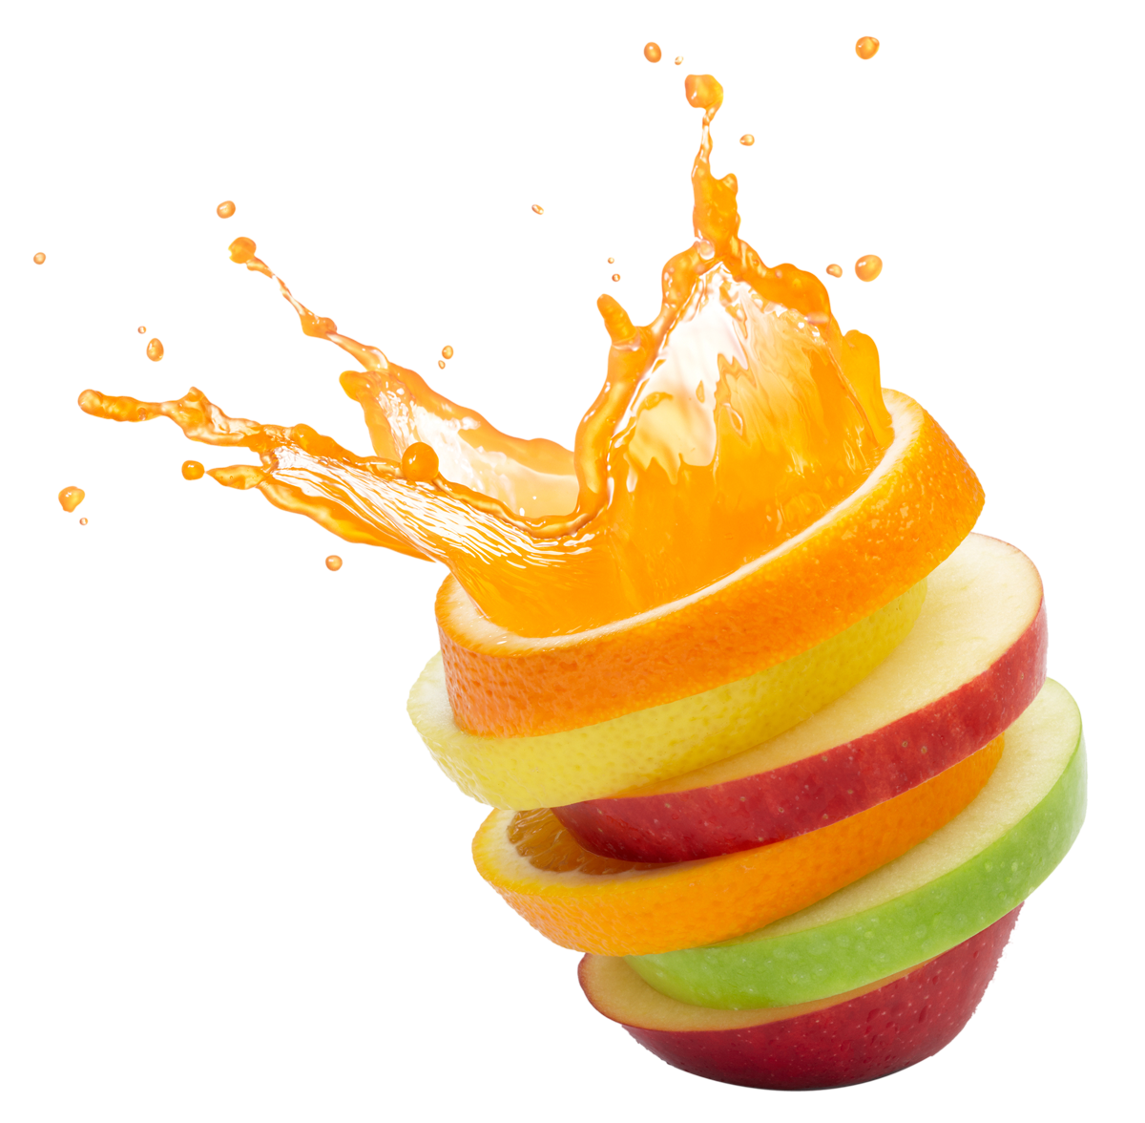
WOAH.. that’s a lot of water!
Getting enough water can actually be really simple. Here are some suggestions:
Take a water bottle with you to class
Drink water with all meals
Add fruit to your water like lemon or strawberry

Slide 10
Think - Pair- Share
What can you do to remember to drink enough water each day?

Slide 11
Quiz 3
Name 3 foods that have a high water content?

Slide 12
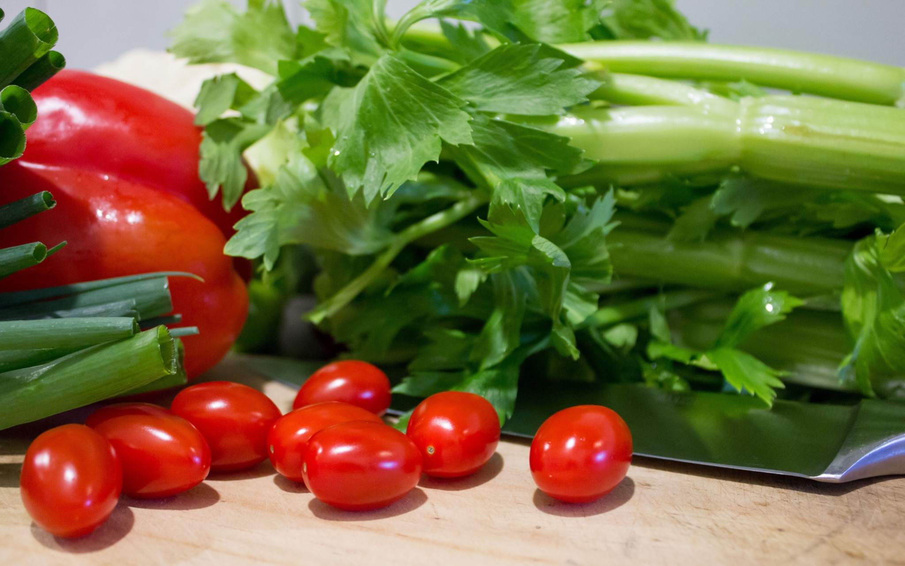
Answer:
Celery, Lettuce, Green pepper, Cantaloupe, Tomatoes, Oranges, Pineapple

Slide 13
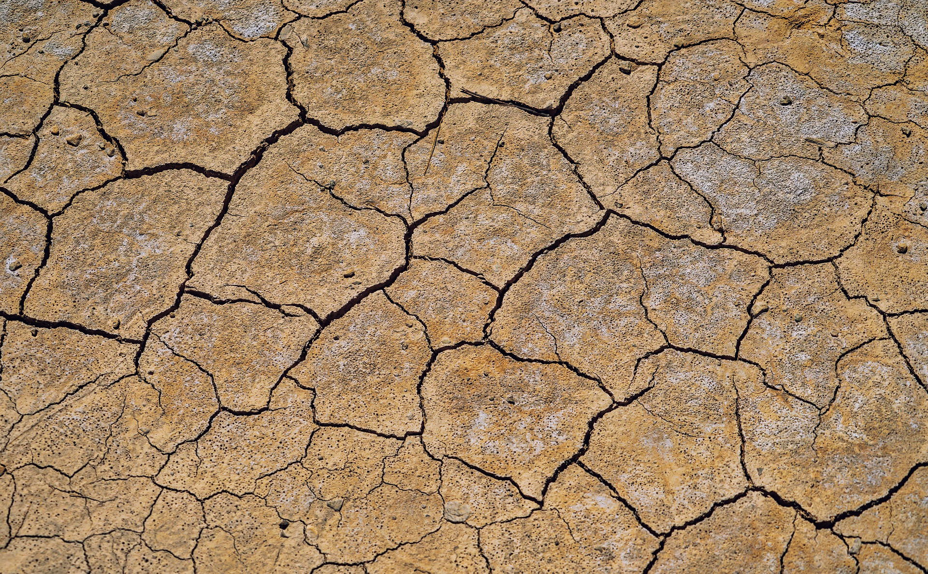
What if I don’t get enough water?
Signs of Dehydration
Thirst
Dry lips and dry mouth
Flushed skin
Headache
Dizziness and fainting
Dark yellow, strong smelling urine

Slide 14
Quiz 4
Do pop, juice, and slushies count toward your overall water intake?

Slide 15
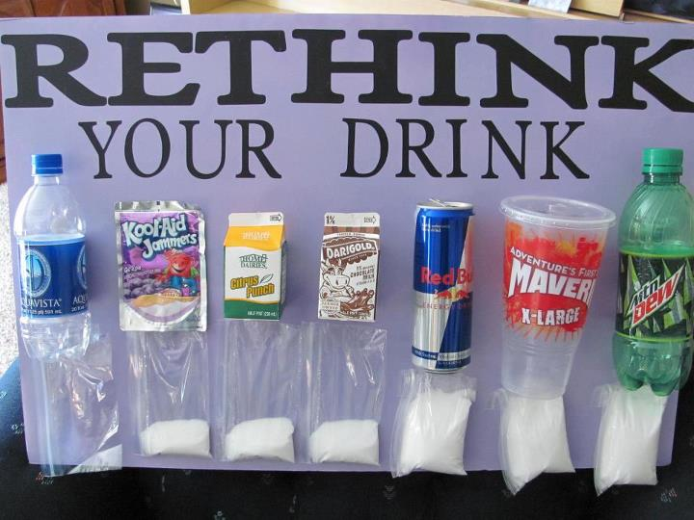
Answer:
Pop, juice, and slushies do contain water. However, they also contain high amounts of sugar and some contain caffeine. Therefore, plain water is always the healthier choice.

Slide 16
All that sugar is in pop and slushies?!
I love my body and I want to fuel it well so it continues to function properly. So I will try to limit the amount of sugary drinks I have and stick to water instead!!

Slide 17
References
https://www.eatrightontario.ca/en/Articles/Water/Facts-on-Fluids-How-to-stay-hydrated.aspx
https://www.dietitians.ca/Your-Health/Nutrition-A-Z/Water/Why-is-water-so-important-for-my-body---Know-when-.aspx
https://food-guide.canada.ca/en/healthy-eating-recommendations/make-water-your-drink-of-choice/

