Slide 1
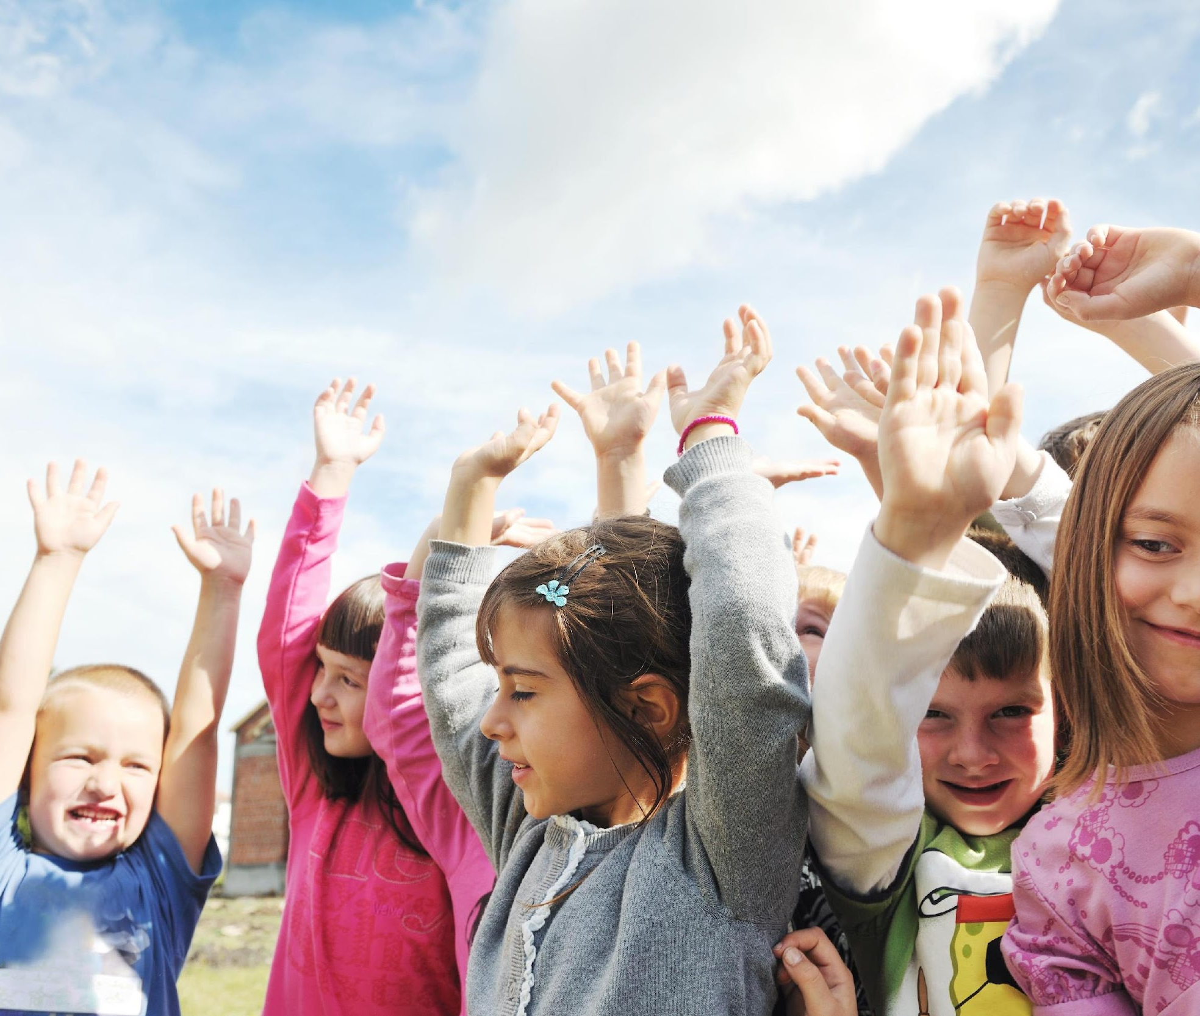
Day 1: 12 Days of Fitness
This holiday season remember to stay healthy! On the announcements during the month of December we are going to do the 12 Days of Fitness! Each day, a new activity will be added to the list. Check out the bulletin board insert location of bulletin board to see a new activity unveiled each day.

Slide 2
Day 2: 12 Days of Fitness
Don’t forget that we will be starting our 12 Days of Fitness on Monday. Make sure to drink plenty of water this weekend so you’re ready for our first activity. This can be changed to fit the dates for December.

Slide 3
Day 3: 12 Days of Fitness
We are starting our 12 Days of Fitness today! Stand up quietly and get ready to do some actions with us! Are you ready???
“On the first day of fitness insert school name gave to me: One walk around my desk!”
Remember to check out the bulletin board insert location of bulletin board if you want to see pictures of insert school name students performing the actions. Maybe you’ll find a picture of yourself on the board!

Slide 4
Day 4: 12 Days of Fitness
Stand up quietly and get ready to do some actions with us for the 12 Days of Fitness. It’s the second day of fitness! Get ready…
“On the second day of fitness insert school name gave to me:
Two toe touches
And one walk around my desk”

Slide 5
Day 5: 12 Days of Fitness
Stand up quietly and get ready to do some actions with us for our 12 Days of Fitness.
“On the third day of fitness, insert school name gave to me:
Three muscle poses
Two toe touches
And One walk around my desk”

Slide 6
Day 6: 12 Days of Fitness
Stand up quietly and get ready to do some actions with us for our 12 Days of Fitness.
“On the fourth day of fitness, insert school name gave to me:
Four desk push ups
Three muscle poses
Two toe touches
And ONE walk around my desk”

Slide 7
Day 7: 12 Days of Fitness
Stand up quietly and get ready to do some actions with us for our 12 Days of Fitness.
“On the Fifth day of fitness, insert school name gave to me:
Five high fives
Four desk push ups
Three muscle poses
Two toe touches
And one walk around my desk”

Slide 8
Day 8: 12 Days of Fitness
Stand up quietly and get ready to do some actions with us for our 12 Days of Fitness.
“On the sixth day of fitness, insert school name gave to me:
Six shoulder shrugs
Five high fives
Four desk push ups
Three muscle poses
Two toe touches
And one walk around my desk”

Slide 9
Day 9: 12 Days of Fitness
Stand up quietly and get ready to do some actions with us for our 12 Days of Fitness.
“On the seventh day of fitness, insert school name gave to me:
Seven arm circles
Six shoulder shrugs
Five high fives
Four desk push ups
Three muscle poses
Two toe touches
And one walk around my desk”

Slide 10
Day 10: 12 Days of Fitness
Stand up quietly and get ready to do some actions with us for our 12 Days of Fitness.
“On the eighth day of fitness, insert school name gave to me:
Eight knee lifts
Seven arm circles
Six shoulder shrugs
Five high fives
Four desk push ups
Three muscle poses
Two toe touches
And one walk around my desk”

Slide 11
Day 11: 12 Days of Fitness
Stand up quietly and get ready to do our 12 Days of Fitness. “On the ninth day of fitness, insert school name gave to me:
Nine seconds rest
Eight knee lifts
Seven arm circles
Six shoulder shrugs
Five high fives
Four desk push ups
Three muscle poses
Two toe touches
And one walk around my desk”

Slide 12
Day 12: 12 Days of Fitness
Stand up quietly and get ready to do our 12 Days of Fitness. “On the tenth day of fitness, insert school name gave to me:
Ten calf raises
Nine seconds rest
Eight knee lifts
Seven arm circles
Six shoulder shrugs
Five high fives
Four desk push ups
Three muscle poses
Two toe touches
And one walk around my desk”

Slide 13
Day 13: 12 Days of Fitness
Stand up quietly and get ready to do our 12 Days of Fitness. “On the eleventh day of fitness, insert school name gave to me:
Eleven chair sit squats
Ten calf raises
Nine seconds rest
Eight knee lifts
Seven arm circles
Six shoulder shrugs
Five high fives
Four desk push ups
Three muscle poses
Two toe touches
And one walk around my desk”

Slide 14
Day 14: 12 Days of Fitness
Stand up quietly and get ready for our 12 Days of Fitness. It’s our last day! “On the twelfth day of fitness, insert school name gave to me:
Twelve jumping jacks
Eleven chair sit squats
Ten calf raises
Nine seconds rest
Eight knee lifts
Seven arm circles
Six shoulder shrugs
Fiiiive hiiiigh fiiiiiives
Four desk push ups
Three muscle poses
Two toe touches
And one walk around my desk”

Slide 15
Day 15: 12 Days of Fitness
There are many fun ways to stay fit over the holiday season. How about going outside and playing catch? Playing catch isn’t just a summer activity, it can be even more fun when you play it in the snow.
Give it a try!

Slide 16
Day 16: 12 Days of Fitness
Making the healthy choice can be hard over the holidays.
By choosing delicious, nutritious fruit instead of less healthy squares and candy, you are well on your way to having a healthy holiday season.

Slide 17
Day 17: 12 Days of Fitness
Remember to keep fit over the holiday break, try some of the activities we learned about during the 12 Days of Fitness.
See you in the New Year!

