Slide 1
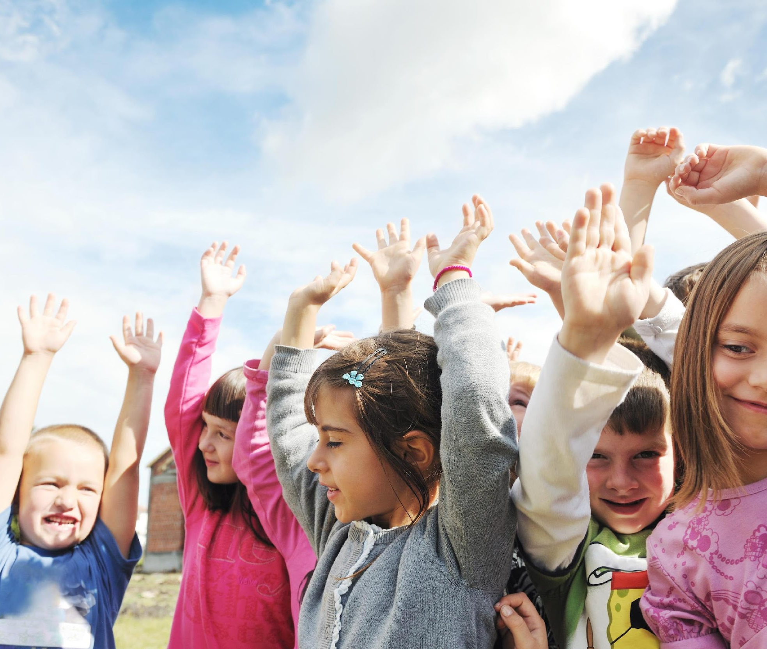
Day 1: Be a Sleep Star
This month we are going to learn all about being a “Sleep Star”. Sleep is a very important part of keeping our minds and bodies healthy. After getting a good night’s sleep tonight, you can come to school tomorrow ready to learn and to be active at recess and in your physical education classes.

Slide 2
Day 2: Be a Sleep Star
Did you know that kids aged 5-12 need 10-11 hours of sleep every night? Your brain and body are like a cell phone. They need to recharge while you are sleeping so that you have energy all day long. To see how much sleep you had last night, we are going to test your energy level by doing 10 bunny hops on the spot. Please stand up, push in your chairs and get ready to move.
Good job! I bet your teachers can see who was a “Sleep Star” last night.

Slide 3
Day 3: Be a Sleep Star
Did you get 10-11 hours of sleep last night? If you didn’t, it might be time to look at why not.
Try to remember if you had any caffeine yesterday. Things like Iced Caps, coffee, tea, energy drinks, Coke and chocolate all have caffeine in them. Caffeine is a drug, which makes it hard for your body and brain to relax or sleep. Try not to have any caffeine today and see if it helps you be a “Sleep Star” tonight.

Slide 4
Day 4: Be a Sleep Star
Another reason it can be hard to get enough sleep is that you may not have a bedtime routine. If you try to do the same thing every evening before bed it can help you to get settled and fall asleep sooner. Some people like to read a book or take a bath before bed every night to help them relax.
What is your bedtime routine?

Slide 5
Day 5: Be a Sleep Star
Have you ever heard of stress? Stress is what you feel when you are worried or uncomfortable about something. The worry in your mind can make your body feel tired and run down. Stress is the main reason people have a hard time being a Sleep Star.
Doing relaxing activities before bed help reduce stress. Listening to calming music and making your bedroom dark, quiet and cool can all help your stress go away so you can be a “Sleep Star”.
Counting sheep can help distract you from thinking about the day’s activities so you can relax. Let’s all practice counting by doing 10 star jumping jacks to show everyone that we can be “Sleep Stars”!

Slide 6
Day 6: Be a Sleep Star
Here’s another tip so you can be a “Sleep Star”. Did you know that our bodies produce a hormone called melatonin, which is our sleep hormone. Our bodies ability to produce this sleep hormone is affected by light. If you are in front of the bright lights of a television, computer or cell phone before bed, your body will not make enough melatonin for you to get a good night's sleep.
Try reading your favorite book or going for a walk instead of staring at a screen before bed.
Please turn to your neighbor and tell them one thing you could do to be a “Sleep Star”.

Slide 7
Day 7: Be a Sleep Star
Do you remember what the sleep hormone is called?
Come and tell (insert teacher or facilitator name here) _________ today and show them what you know about being a “Sleep Star”.

Slide 8
Day 8: Be a Sleep Star
Has anyone ever had an awesome dream? Dreams happen when we are in a sleep pattern called "Rapid Eye Movement" or REM. If we are not getting enough sleep, it is very difficult for our bodies to get into REM sleep and have dreams.
Take a minute now and think of the best dream you have had lately.

Slide 9
Day 9: Be a Sleep Star
Yesterday we talked about Rapid Eye Movement sleep or REM sleep. The other type of sleep that we have is called "Non Rapid Eye Movement" or NREM sleep. During this type of sleep, we get more blood flow to our muscles, our energy is restored, our body tissues grow and repair and important hormones are released.
All of these things are important to help our bodies grow healthy and strong.

Slide 10
Day 10: Be a Sleep Star
Can you remember what the 2 types of sleep that we learned about are? Did you get enough sleep last night to have both of these types of sleep?
Come and tell insert teacher or facilitator name here)_________ if you can remember what the 2 types of sleep are.

Slide 11
Day 11: Be a Sleep Star
Raise your hand if you sleep in on weekends! Did you know that you actually can't "catch up" on sleep by sleeping in on the weekends?
It is healthier to try to go to bed a little earlier each night and "catch up" that way. It will also mean that you won't spend your whole Saturday in bed so you can go enjoy a day of playing outside with your friends.

Slide 12
Day 12: Be a Sleep Star
We learned that one of the reasons sleep is so important is so that our brains and bodies can rest and recharge. Another reason is that if we don't sleep enough, it is harder to make decisions. Our brain may take try to take breaks during the day to try and recharge - but during your brain’s breaks, it will be really hard to make a positive choice or to do well on a test.
By getting your 10-11 hours and becoming a “Sleep Star”, you can stay focused in school and get great grades without having to shut down during the day!

Slide 13
Day 13: Be a Sleep Star
The amount of sleep we get is strongly tied to our bedtime routine. In order to stay healthy, we need to make sure we turn off the TV and make our move to a healthier bedtime routine. What are some ways that you can create a healthy bedtime routine?
Write them on a piece of paper and share it with (insert teacher or facilitator name here)_________ for a chance to have your answer shared on the announcements! Don’t forget to include dental health in your routine as well!

Slide 14
Day 14: Be a Sleep Star
Are you being a “Sleep Star”?
______________from Grade_____Room____ says_________.
If anyone has any more ways you can create a healthy bedtime routine come and tell insert teacher or facilitator name here)_________.

Slide 15
Day 15: Be a Sleep Star
We’ve all stayed up late. Do you remember how you felt the next day? Probably a little tired and maybe a little like you want to go back to sleep. 60% of kids feel tired through the day and 15% admit to falling asleep in class. It's really hard to learn when you are asleep at school. Try adding something relaxing into your bedtime routine tonight so you are ready to learn tomorrow.
Remember, the bright lights in a TV, computer screen or cell phone make it harder to sleep, so look for non-technology ways to relax so you can be a “Sleep Star”.

Slide 16
Day 16: Be a Sleep Star
When you don't get enough sleep your energy tends to be lower and you do not want to be active. When you do get enough sleep, you will have more energy to run and play all day at school and after school. Physical activity is a great way to tire out your body so that you are ready to go to sleep at bedtime.
Instead of going home after school and turning on the computer or playing video games, try playing outside at the park or in your backyard! This will help you become a “Sleep Star”.

Slide 17
Day 17: Be a Sleep Star
Being physically active helps our whole body stay healthy and happy. Because stress can affect sleep, being active is important. Physical activity helps reduce our stress levels. Make sure you get 60 minutes of moderate to vigorous physical activity every day. Your cheeks should be red, you should feel warm and sweaty for 60 minutes every day!
Let’s show your teachers who has been a “Sleep Star”! Let’s see how much energy you have. Start by touching the floor, then jump up into the air and make a star shape with your body. These are Starman Jumps.
Great job! It sure sounds like everyone had a good night’s sleep and is ready to learn!

Slide 18
Day 18: Be a Sleep Star
Eating healthy is important for keeping our bodies growing strong. Are you choosing a healthy snack before bedtime? Choosing healthy snacks like vegetables or fruit instead of Choose Least Often foods high in sugar, fat or salt will help you be a “Sleep Star”.
Check the school’s newsletter this month for a healthy bedtime snack that you can try!

Slide 19
Day 19: Be a Sleep Star
Hitting the snooze button in the morning may seem like a great way to get a little more sleep but it can actually work against you. By only sleeping for a few minutes your sleep patterns are interrupted and you don't get to either of the 2 types of sleep we learned about. Does anyone remember the 2 types of sleep?
Write down your answer and give it to insert teacher or facilitator name here if you know the answer. I will give you a hint; the initials for these two types of sleep are “REM” & “NREM”.

Slide 20
Day 20: Be a Sleep Star
Have you ever heard about "sleep hygiene?" This is about the things you do to help you sleep. We talked about listening to calming music, reading a book, following your routine every night, and not being in front of a media screen. Are you being a “Sleep Star”? Read one of the student’s answers on how to create a healthy bedtime routine. Student from Grade_____Room____ says………….
Can anyone think of another relaxing activity that would help your "sleep hygiene?" Come and tell insert teacher or facilitator’s name here ______ when you think of one.

Slide 21
Day 21: Be a Sleep Star
Are you feeling a bit sleepy today? Try playing an active game at recess time. This will get your blood pumping and your brain working so you are ready to learn today and to be a “Sleep Star” tonight!
Remember that our pajama day is coming up so get ready to show everyone what you wear to be a “Sleep Star”.

Slide 22
Day 22: Be a Sleep Star
Did you know that lions are the “Sleep Stars” of the animal kingdom? Lions sleep up to 20 hours every day! That means that they are only awake for about 4 hours a day and it is usually at night. Kids between the ages of 5-12 should probably try to stick with sleeping 10-11 hours a night and teenagers should stick with sleeping between 8.5 and 9.25 hours a night.
Does anyone have any animals at home? I wonder how many hours they sleep in a day?

Slide 23
Day 23: Be a Sleep Star
Today is pajama day! Hopefully everyone wore their favorite pajamas today. Tell your teacher about one thing that you learned this month while you perfected being a “Sleep Star”.
Remember that just because you are wearing pajamas doesn’t mean you can sleep in class. Great job this month “Sleep Stars”!

