Slide 1
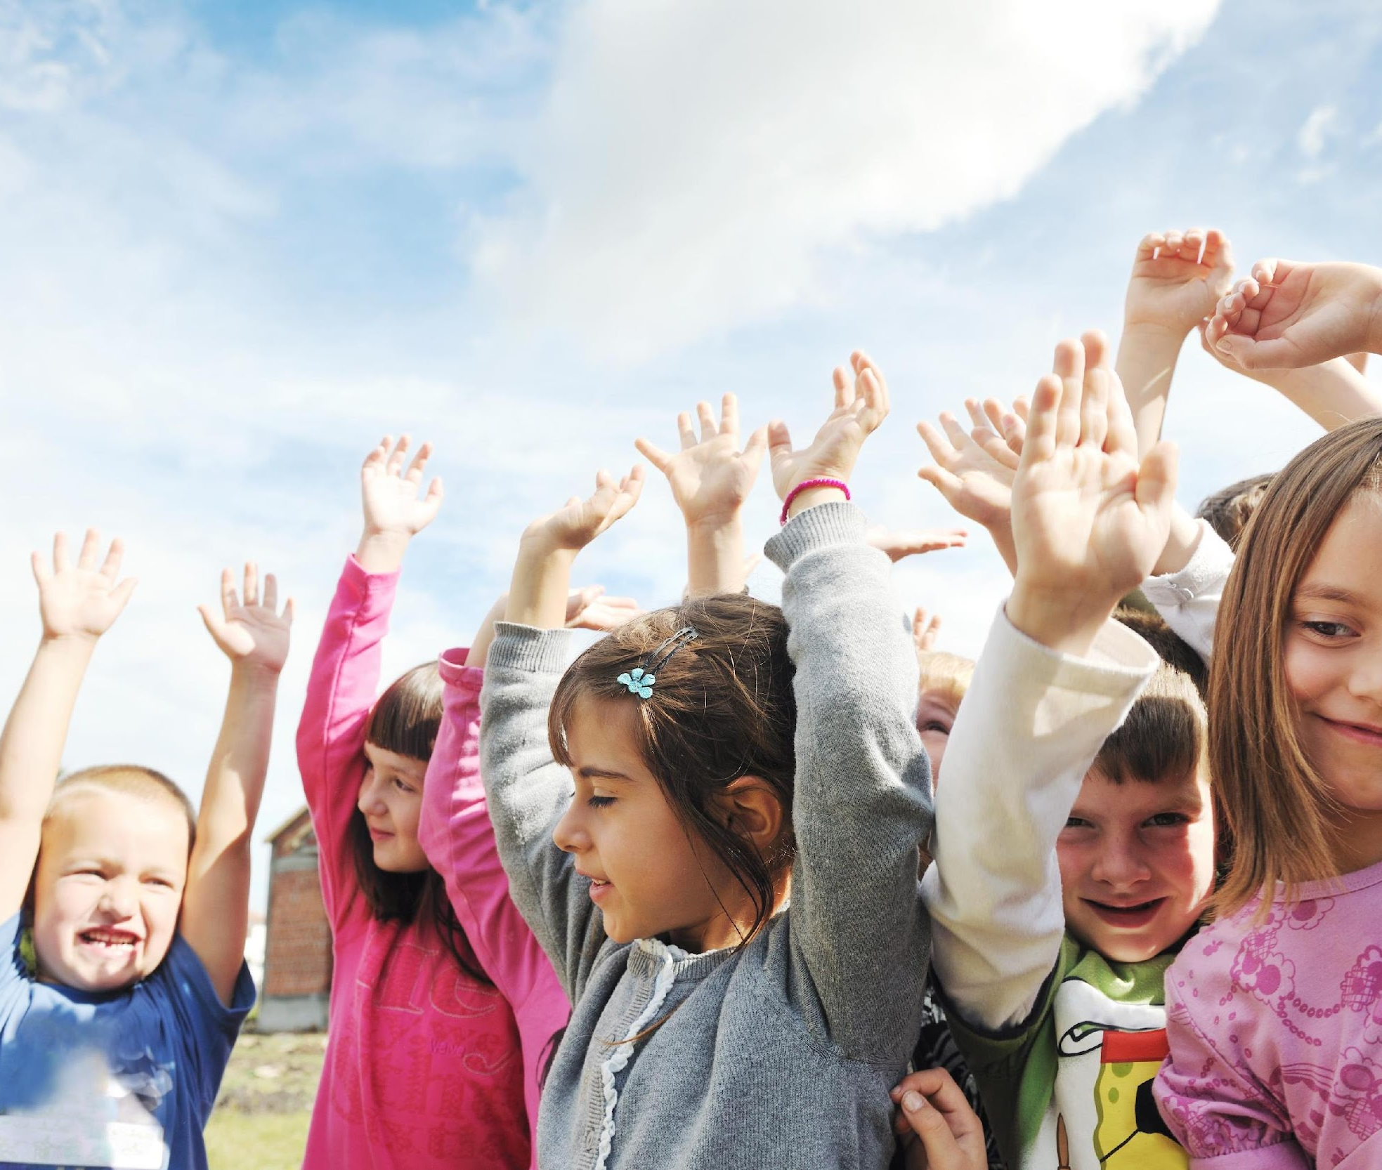
Day 1: Bone Bounce Blitz
In October we will be talking about bones! Did you know that we can make our bones stronger by the things we eat AND the things we do? This month we will learn all about different ways to keep our bones healthy, so stay tuned!

Slide 2
Day 2: Bone Bounce Blitz
It is important to start the week out right, and a great way to do that is to get moving. Over the month we will be learning some great exercises that can help to strengthen our bones. Everyone please stand up and push your chairs in.
This week’s activity is jumping jacks. If you don’t know how to do a jumping jack, try hopping on the spot. We will be doing them for 30 seconds. Are you ready? Here we go!

Slide 3
Day 3: Bone Bounce Blitz
Today we are going to learn about a food that can help build and keep our bones strong.
Have you ever had cottage cheese? Cottage cheese can be served many ways. Some people eat it with fruit or sprinkle it on their pasta. Cottage cheese helps to keep our bones strong because it has calcium in it.

Slide 4
Day 4: Bone Bounce Blitz
Did you know that when a baby is born, it has over 300 bones! As we grow some of those bones fuse together. As adults we have 206 bones. Over half of our bones are in our hands and feet!
These are important bones because they allow us to write stories and run at recess.

Slide 5
Day 5: Bone Bounce Blitz
Today I have a bone riddle for you.
I am a group of bones that join together and act like a house for nearly all of your vital organs including your heart, lungs, and liver. Need another hint? I have 2 words in my name and one of them rhymes with fib. (Answer: Rib Cage)

Slide 6
Day 6: Bone Bounce Blitz
I have a joke for you today.
Q: Why didn't the skeleton dance at the Halloween party?
A: It had no body to dance with.
Dancing is a great way to be active and have fun. Whether you are dancing with a partner, with a group of friends, or by yourself, all the moving, jumping and smiling will do your body good!

Slide 7
Day 7: Bone Bounce Blitz
Jumping for 90 seconds everyday can increase your bone density, which means your bones will be stronger. Today we are going to try jumping up and down and reaching for the stars.
Please stand up and push your chair in. We will be doing this for 30 seconds. Are you ready? Here we go!

Slide 8
Day 8: Bone Bounce Blitz
Today we are going to learn about a food that can help keep our bones strong.
You have probably had flavored yogurt before, but have you ever tried plain yogurt? It is a little tangy, and not really that sweet. Plain yogurt is often served with spicy foods to help reduce the spice on your tongue and in your mouth. Both flavored and plain yogurts are good sources of calcium, which help to keep your bones strong.

Slide 9
Day 9: Bone Bounce Blitz
Did you know that the body’s smallest bone is in the ear? It is called the stirrup bone and is the size of half a grain of rice. Our biggest bone is in the leg and is called the femur or thighbone. The strongest bone in the skeleton is the jawbone, which helps us to eat our healthy snacks like apples and carrots.

Slide 10
Day 10: Bone Bounce Blitz
Today I have a bone riddle for you.
My medical name is patella, but you know me by a different name. I am a small bone in the leg and I am shaped like a flat stone. Need another hint? Take your index finger and place it on your thigh. Now draw a line forward. I am the first bone you hit. (Answer: Knee Cap)

Slide 11
Day 11: Bone Bounce Blitz
Good morning everyone. I have a joke for you today.
Q: How do skeletons call their friends?
A: On the telebone!
The telephone is a great way to set up play-dates with your friends. Get outside and be active during the fall before the snow falls!

Slide 12
Day 12: Bone Bounce Blitz
Jumping activities are great for strengthening our bones.
Today we are going to try doing some chicken jumping jacks! A chicken jack is exactly like a jumping jack except you pretend that you use your arms as if they were wings of a chicken. Please stand up and push your chair in. We will be doing this move for 30 seconds. Are you ready? Here we go!

Slide 13
Day 13: Bone Bounce Blitz
Today we are going to learn about a food that can help keep our bones strong.
Have you ever tried Kefir (pronounced kee-fur)? This nutritious drinkable-style yogurt is made from milk and the kefir grain. Kefir has more of a tart flavour than yogurt and is a delicious alternative to regular milk on your cereal!

Slide 14
Day 14: Bone Bounce Blitz
Calcium is really important for growing bones, keeping bones strong and helping a broken bone heal. Did you know that a broken bone takes about 12 weeks to heal? Did you also know that the place where the bone was broken will be the strongest part of the bone after it heals? People rarely have the same broken bone twice!
Can you think of a food that has calcium in it that will help keep our bones strong?

Slide 15
Day 15: Bone Bounce Blitz
Today I have a bone riddle for you.
When babies are born I am only 4 pieces. As a person gets older I fuse together to make one mega-strong dome shaped-bone. I protect your body’s most complex organ. What am I? Need a hint: People say it is important to protect me when I am on 2 wheels!(Answer: Skull)

Slide 16
Day 16: Bone Bounce Blitz
Jumping activities are great for strengthening our bones. This week we will be doing all 3 types of jumps we learned this month. The first one is the jumping jack, the second is jumping high for the stars, and the third is the chicken jumping jack.
Please stand up and push your chair in. We will be doing each move for 15 seconds. Are you ready? Here we go!

Slide 17
Day 17: Bone Bounce Blitz
Today we are going to learn about a food that can help to keep our bones strong.
Goat cheese is made similar to regular cheese. It tends to be soft cheese instead of hard cheese which makes it fun to spread on some crackers or carrot sticks! Give goat cheese a try today!

Slide 18
Day 18: Bone Bounce Blitz
Did you know that the centers of our bones are not solid bone?
Bones are filled with a spongy substance called bone marrow which is where red blood cells are made. Red blood cells carry oxygen in our blood so we can breathe. Bones help us breathe too!
WOW our bones do a lot of things for our body!

Slide 19
Day 19: Bone Bounce Blitz
Today I have a bone riddle for you.
I am the largest bone in the human body. I am crucial for running and you are born with two of me. What bone am I? Do you need another hint? I rhyme with “streamer”. (Answer: Femur)

Slide 20
Day 20: Bone Bounce Blitz
I have a joke for you today.
Q: What do skeletons have nightmares of?
A. Dogs
People can keep their bones healthy by drinking milk which has calcium in it. Milk is not good for dogs, but that is ok because they can get calcium by chewing bones. Chewing bones also helps to keep their teeth and gums clean and can give them nearly all the nutrients they need to live long and healthy lives.

Slide 21
Day 21: Bone Bounce Blitz
Fortified soy beverages are also a great source of calcium to help build strong bones. Children aged 4-8 need 2 servings of Milk and Alternatives a day and Children aged 9-13 need 3-4 servings of Milk and Alternatives a day.
There are many ways to meet your daily servings of Milk/Alternatives to help build strong bones. Why not try different types of cheeses this week, making a fruit smoothie with yogurt or kefir or replacing water with milk in recipes such as pancakes or soup.

Slide 22
Day 22: Bone Bounce Blitz
Did you know that there is 1 dairy cow for every 20 Canadians? That means that there are about 1.7 million dairy cows working hard to produce all the delicious milk and dairy products that we can find in our grocery stores.

Slide 23
Day 23: Bone Bounce Blitz
Yesterday we learned that there are about 1.7 million dairy cows in Canada. Did you know that it takes 50-70 hours for a cow to turn the grass they eat into milk? That is a lot of work!

