Slide 1
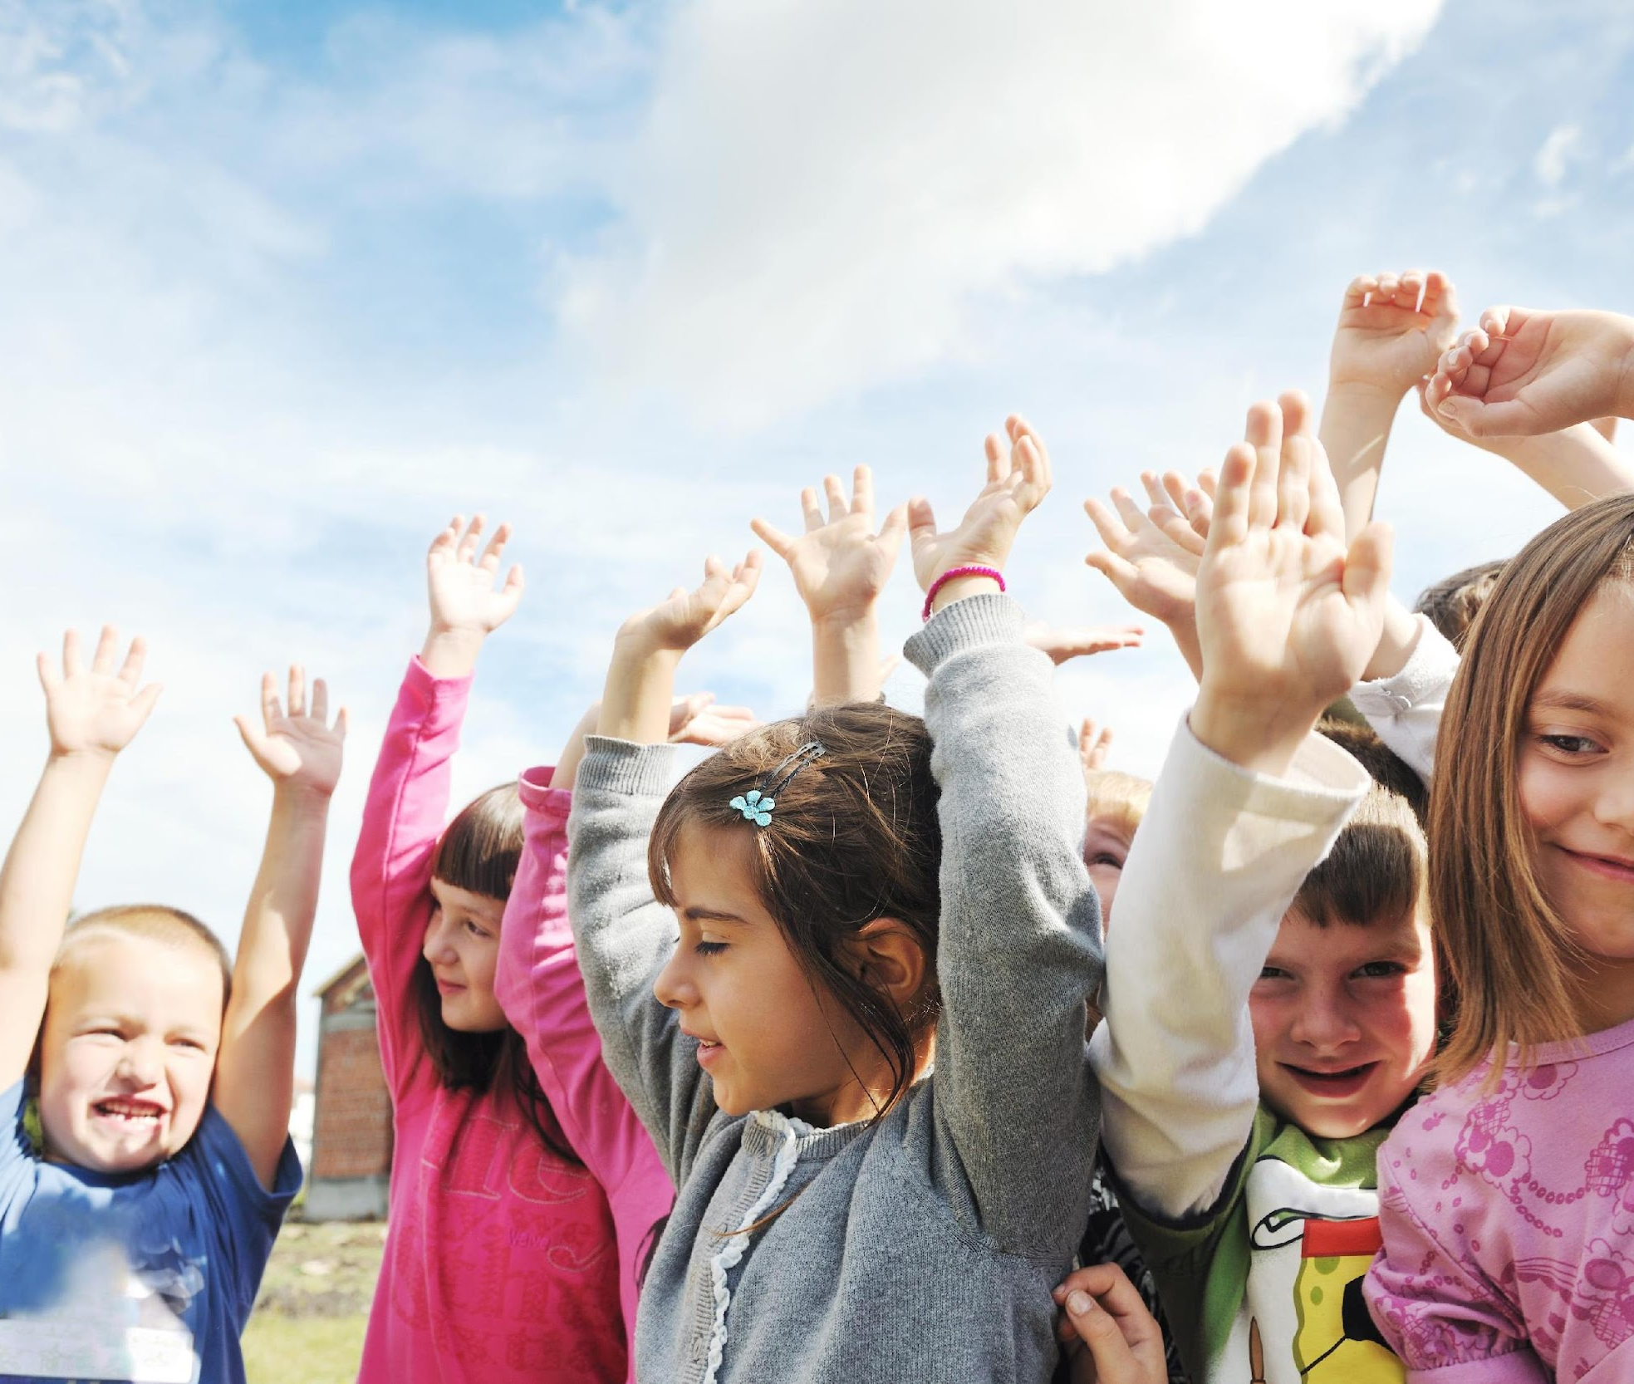
Day 1: Dream Team
This month we’ll be talking about sleep and dreams. Throughout the month we’ll become a Dream Team as we work toward having great quality sleeps and lots of sweet dreams. We’ll also learn lots of fun tips and tricks to have a restful sleep every night.

Slide 2
Day 2: Dream Team
Dreaming is an important part of sleep. Dreams help us to control our emotions and stay happy! Do you remember any dreams you had last night?
Turn to the person next to you and tell them something that happened in one of your dreams.

Slide 3
Day 3: Dream Team
Have you ever heard of REM sleep? REM stands for Rapid Eye Movement.
This is the sleep stage when we dream! Our muscles are completely relaxed in this stage, but our heartbeat gets quicker and our eyes move underneath our eyelids. Try it! Close your eyes and move your eyes around. That’s what happens at night when we are dreaming.

Slide 4
Day 4: Dream Team
Yesterday we learned about a special kind of sleep that we have when we’re dreaming. Do you remember the name of that kind of sleep? If you do, tell your teacher.

Slide 5
Day 5: Dream Team
Did you know that we spend about one-third of our lives sleeping? That is more time than we spend at school and much more than we spend eating! Sleep is very important for our health which is one of the reasons we spend so much time sleeping.

Slide 6
Day 6: Dream Team
While we are falling asleep, we enter stage 1 of our sleep cycle. This is a very light sleep stage where we could wake up very easily. If you ever see a friend dozing off in class, they are probably in stage 1. If you woke them, they’ll probably say something like “I’m awake, I was just resting my eyes.” It is important that you get a long enough sleep so that you get to the deeper sleep stages more often.
Remember: we need deep sleep to grow and dream!

Slide 7
Day 7: Dream Team
About every one-and-a-half hours your body goes through stages 2, 3, 4, and REM before it begins the cycle again. If you had 9 hours of sleep total, how many cycles would your body go through?
Answer: 6 cycles of sleep

Slide 8
Day 8: Dream Team
A great way to ensure you get a good sleep and lots of sweet dreams is to get physical activity throughout the day. This helps you feel more tired when you go to bed. Now is a perfect time to get some physical activity by doing some jumping jacks!
Stand up and make sure you have plenty of room around you. Ready? Set? Let’s go!

Slide 9
Day 9: Dream Team
If you are between 5 and 13 years of age, you should get 9 to 11 hours of sleep each day. That may sound like a lot, but did you know that lions need 20 hours of sleep every day? 20 hours of sleep a day, wow, they must dream a lot!

Slide 10
Day 10: Dream Team
Yesterday we learned how many hours of sleep you should get if you are 5 to 13 years old. Does anyone remember?
If you forgot, the answer is 9 to 11 hours of sleep. See if you can remember that number to share with someone in your family tonight.

Slide 11
Day 11: Dream Team
Getting enough sleep is very important to help you rest after a long day.
Try to get enough sleep each night so you are able to learn, and your muscles can recover so you can be alert and happy the next day!

Slide 12
Day 12: Dream Team
Do you ever find yourself forgetting things you learned, or what you have to do at school each day?
That could be because you’re not getting enough REM sleep. REM sleep helps us remember everything we need to keep track of!

Slide 13
Day 13: Dream Team
Dream journals are a great way to help you remember all the fun dreams you had last night. As soon as you wake up tomorrow morning, try writing down anything that you remember about a dream the night before.
If you’re having trouble remembering your dreams, try writing down or drawing something you’d like to dream about.

Slide 14
Day 14: Dream Team
When we don’t get to sleep and dream it makes it harder for us to manage our mood. Just like using the word Hangry (hungry and angry combined) for when we are angry because we are hungry.
There should be a word for when we are overtired and grumpy. Maybe Slumpy (sleepy and grumpy combined) or Slangry (sleepy and angry combined) or Grumpired (grumpy and tired combined).

Slide 15
Day 15: Dream Team
Looking at a screen like a TV or cell phone right before bed makes it difficult to fall asleep. Even if you fall asleep right away after looking at screens, it takes your body longer to get to deep sleep.
To make sure you have sweet dreams, try reading a book, playing a board game, drawing a picture, or doing another fun activity in the hours before bed.

Slide 16
Day 16: Dream Team
Got a problem? Sleep on it! Getting plenty of REM sleep can really help our problem-solving skills. If you’re struggling with a math problem, try to get a great sleep tonight to help you figure it out tomorrow!

Slide 17
Day 17: Dream Team
When you get a good night’s sleep, every part of your body works better! Your stomach, your muscles, your brain and everything else needs a great sleep to help you be the best you can be!

Slide 18
Day 18: Dream Team
Did you know that getting REM sleep can help you be more creative? If you need some more creative ideas, make sure you get a good night’s sleep tonight.

Slide 19
Day 19: Dream Team
We have learned lots about REM sleep and dreams this month! Turn to the person next to you and tell them one thing you do each day to make sure you have a great sleep each and every night!

Slide 20
Day 20: Dream Team
Have you ever heard of sleep debt? When you don’t sleep enough, your body needs to catch up. This is called sleep debt. Sleeping in on weekends won’t do the solve this problem. You need to make sure you’re getting enough sleep every day to properly catch up.
Before you can dream you need to catch up on any sleep debt you have. If you are always in a sleep debt you won’t have as many sweet dreams!

Slide 21
Day 21: Dream Team
How many hours did you sleep last night? Do you feel energized and ready for the day? If not, you might need to go to bed just a little earlier tonight so you can get enough sleep and spend more time dreaming!

Slide 22
Day 22: Dream Team
This month we have learned so many fun things about sleep and dreams! Sleep is very important to make sure you stay healthy and happy, and dreams are a big part of getting a good night’s sleep.
Let’s keep using everything we’ve learned to become a Dream Team. Sweet dreams everyone!

