Slide 1
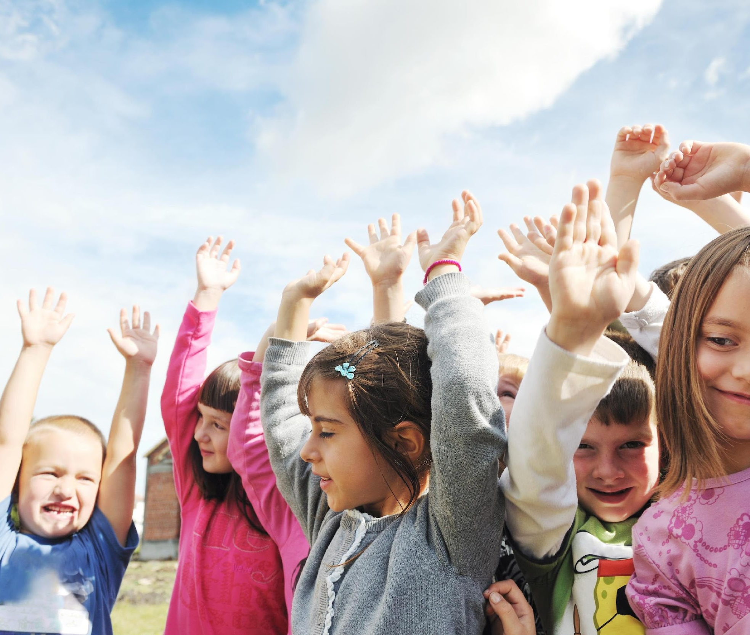
Day 1: Fun in the Sun with Vita-man D
May means it’s time for some Fun in the Sun with Vita-Man D! This month we will be talking about having fun in the summer time, about sun safety facts and about the importance of the sunshine vitamin to keep our bones strong and healthy.
Check out Vita-Man D on the Bulletin Board insert location here.

Slide 2
Day 2: Fun in the Sun with Vita-man D
Even though the sun provides our bodies with vitamin D, we need to make sure if we are spending a lot of time in the sun, we protect our skin from the suns harmful rays. Vita-Man D wants to know if you can think of three things you could do to protect yourself from the sun?
Be sure to tell Name of champion teacher what you thought of!

Slide 3
Day 3: Fun in the Sun with Vita-man D
Yesterday I asked you about three things we could use to protect ourselves from the sun.
Some things we can do to protect ourselves from the suns strong rays are: applying sunscreen, wearing a hat and wearing sunglasses.

Slide 4
Day 4: Fun in the Sun with Vita-man D
Vita-Man D is definitely a superhero! How can you add more vitamin D to your meals and supercharge your day?
Try using milk or fortified soy beverage instead of water when making pancakes, muffins, soups, puddings, smoothies and sauces for a bone strengthening delight.

Slide 5
Day 5: Fun in the Sun with Vita-man D
Vitamin D is needed by many parts of the body, including muscles, nerves, skin, glands, and the immune system. Vitamin D is very important in helping our body to absorb calcium and make your bones strong.
Vita-Man D wants to remind everyone that milk is a great source of vitamin D and is a great way to strengthen our super bones.

Slide 6
Day 6: Fun in the Sun with Vita-man D
Vita-Man D found out that his shadow is an indicator of the suns strength. If his shadow is shorter than he is, the sun is at its highest strength. If his shadow is taller he is his sun exposure will be lower.
Next time you are outside try to see where your shadow is and soak up some sun… and some vitamin D.

Slide 7
Day 7: Fun in the Sun with Vita-man D
This summer, Vita-Man D wants us to remember that if it’s cloudy and raining out, we should include good food sources of vitamin D in our lunch.
Foods and beverages like milk, salmon or a tuna sandwich as part of our healthy diet keeps our bones and teeth healthy and strong.

Slide 8
Day 8: Fun in the Sun with Vita-man D
Summer is a great time to get outside and be active!!! As Canadians, we really have to enjoy summer, as it is only two months of the year! Go for a bike ride, play on the playground, or go for a walk.
Our body makes vitamin D when the sun shines on our skin and works with calcium to keep our teeth and bones strong. Vita-Man D wants to remind us to do our bones some good and make sure to spend some time outdoors in the sunshine.

Slide 9
Day 9: Fun in the Sun with Vita-man D
Sunlight is a great source of natural vitamin D. We only need 10-15 minutes of sunlight on our arms and legs to get enough vitamin D for the day.
Vitamin D helps the body absorb calcium from food and to help build and maintain strong bones.

Slide 10
Day 10: Fun in the Sun with Vita-man D
When it is really hot and you are getting really thirsty, try eating some watermelon. Watermelon is 92% water, which is a very delicious way to rehydrate.
Watermelon is one of Vita-Man D’s favorite summertime fruits!

Slide 11
Day 11: Fun in the Sun with Vita-man D
May means it’s time for some Fun in the Sun with Vita-Man D! Let’s start with a joke today:
Q: What is Vita-Man D’s favorite day of the week?
A: “Sun”day

Slide 12
Day 12: Fun in the Sun with Vita-man D
Staying hydrated is very important every day, but even more important on hot summer days. We can lose water from our body through sweat; this water needs to be replaced.
Vita-Man D wants to remind you to make sure you sip on water throughout the entire day so your whole body can stay healthy.

Slide 13
Day 13: Fun in the Sun with Vita-man D
During the winter months (October to March), the sun’s rays are not strong enough to allow for adequate vitamin D production in the skin. Be sure to include vitamin D rich foods into your winter diet.
Foods such as milk, egg yolk, and fish are a great way to get your vitamin D when the sun is gone.

Slide 14
Day 14: Fun in the Sun with Vita-man D
Biking, rollerblading and skateboarding are great forms of exercise for the summer. It is important to be safe when we participate in such activities. We should always wear a helmet that fits properly when we get on our bikes, boards or blades. Our bones are living tissues that are constantly being broken down and then rebuilt.
We need to get enough Vitamin D to make our bones strong and healthy to support all of our summer fun activities.

Slide 15
Day 15: Fun in the Sun with Vita-man D
May means it’s time for some Fun in the Sun with Vita-Man D! Last week we talked about a special vitamin that the sun provides for us.
Can you remember which vitamin it is? Come tell Insert Facilitator name your answer at recess to win a prize.

Slide 16
Day 16: Fun in the Sun with Vita-man D
Summer time is when Vita-Man D loves to fill up on berries such as raspberries, strawberries, blackberries, and blueberries! Did you know that there are many U-Picks around Edmonton and area that you can go and pick your own berries?
Berries can be picked and then frozen so that you can enjoy them all year round!

Slide 17
Day 17: Fun in the Sun with Vita-man D
June is around the corner and that means it’s time for some Fun in the Sun with Vita-Man D! So get outside and do some of the fun activities we learned about this year.
Skipping, biking or walking are all great ways to have some fun in the sun and spend time with Vita-Man D!

Slide 18
Day 18: Fun in the Sun with Vita-man D
On a hot summer’s day when you want to curb your thirst, before heading to a convenience store to purchase a slurpee, think about going to your local produce store and buying some juicy fruit.
Fruits like oranges, tangelos, watermelon, and pineapple contain a lot of water which will re-hydrate you and also give you a bit of sweetness too!

Slide 19
Day 19: Fun in the Sun with Vita-man D
May means it’s time for some Fun in the Sun with Vita-Man D! Today we have a riddle. Come tell Insert Facilitator name your answer at recess to win a prize.
There are many levels to complete to master me. People often wear goggles and a cap to compete, you can enjoy me indoors or outdoors, I have different strokes.
What activity am I?

Slide 20
Day 20: Fun in the Sun with Vita-man D
Vita-Man D’s nick-name is the sunshine vitamin because sunlight is a great source of vitamin D! We only need 10-15 minutes of sunlight on our arms and legs to get enough vitamin D for the day! Vitamin D helps the body absorb calcium from food to help build and maintain strong bones.
So get outside and enjoy the sunshine!!!

Slide 21
Day 21: Fun in the Sun with Vita-man D
Time for a joke.
Q:“Did you hear the joke about the watermelon?”
A: “It was pit-i-ful”

Slide 22
Day 22: Fun in the Sun with Vita-man D
According to Health Canada, most children and adults can meet their vitamin D needs by choosing the number of servings of recommended for their age group in the Eating Well with Canada’s Food Guide.
So let’s fill our plate with foods and beverages like milk, eggs and fish to keep our bones, teeth and bodies healthy!

Slide 23
Day 23: Fun in the Sun with Vita-man D
People have known about the bone-building benefits of vitamin D for decades. Did you know that vitamin D can also help you fight off colds and the flu?
Since the sun provides you with a natural source of vitamin D, make sure to spend time outside with your family and friends this summer soaking up the sun, having fun and helping your immune system stay strong!

Slide 24
Day 24: Fun in the Sun with Vita-man D
Remember vitamin D is needed by many parts of the body, including muscles, nerves, skin, glands, and the immune system, so be sure to get outside and soak up the sunshine and vitamin D to keep your entire body healthy and active!

