Slide 1
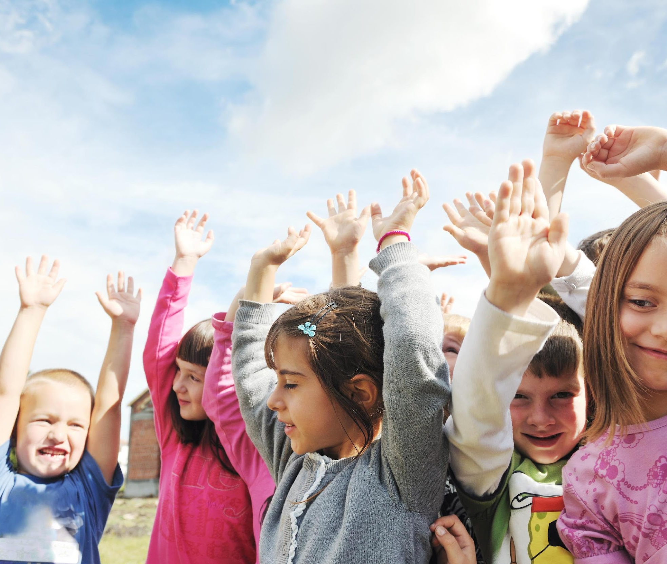
Day 1: Hygiene SUPERHeroes
Welcome back! You probably noticed that due to COVID-19, there have been lots of changes in the world. There are going to be new changes here at school too because we want to keep everyone healthy and safe. But it is not only up to the grown-ups at school, all students in every grade can play a huge part in helping to keep our school healthy and safe.
That’s why we’re calling upon all students and teachers to become Hygiene SUPER Heroes! Hygiene is a set of practices we do in our daily routine that help keep us clean and protect us from germs and getting sick. Things like taking a bath or shower, washing our hands before we eat, cleaning our clothes, or brushing our teeth are common hygiene practices that everyone is familiar with.
This month we will be learning all about healthy hygiene and how each student has the power to protect themselves and the whole school from COVID-19! To find out more about what germs are and why we need to protect ourselves from them, your teacher will share a video with you after the announcements.

Slide 2
Day 2: Hygiene SUPERHeroes
Yesterday we learned what hygiene is and why it’s important that we wash our hands to keep each other safe from COVID-19.
We all need to chip in to keep our school healthy and safe, we can’t just be hygiene heroes -- we need to become Hygiene SUPER Heroes! So how do we all become SUPER you’re wondering? Well, let’s spell it out together!
S stands for Soap or sanitize your hands.
U stands for Use your own items.
P stands for Physical distancing.
E stands for Elbows for coughing and sneezing.
R stands for Recognize symptoms.
So the next time you find yourself asking what you can do to help protect yourself and your school from COVID-19, just remember to be SUPER! Soap or sanitize your hands, Use your own items, Physical distancing, Elbows for coughing and sneezing, and Recognize symptoms.

Slide 3
Day 3: Hygiene SUPERHeroes
Good morning Hygiene SUPER Heroes! Yesterday we learned that each of us has a SUPER hero role to play in keeping our school healthy and safe. One of the best ways to be a Hygiene SUPER Hero is to remember that S stands for soap or sanitize your hands.
Germs live on surfaces like pencils, door knobs, tables and just about anything we touch. We can’t really go through our days trying not to touch anything at all, that’s just not realistic. So what can we do to protect ourselves from germs?
A REALLY, REALLY important way we can protect ourselves is to use soap or hand sanitizer to clean our hands. After the announcements today, your teacher will share a video on how to properly wash your hands. If you have any questions, be sure to ask your teacher!

Slide 4
Day 4: Hygiene SUPERHeroes
Hello Hygiene SUPER Heroes! Does anyone have a favorite song they like to sing while soaping or sanitizing your hands? In yesterday’s video they sang the A-B-Cs when washing hands to make sure they’re washing for at least 20 seconds, but I think my favorite is to sing the first verse of twinkle, twinkle little star.
Can you think of some other songs you can sing while washing your hands? Make sure your song lasts at least 20 seconds because that’s the minimum time you should be washing your hands so that they’re SUPER clean.

Slide 5
Day 5: Hygiene SUPERHeroes
Washing your hands with soap and water is a little different than using hand sanitizer, but they both reach the same goal, which is to clean your hands. Hand sanitizer is easier to use because it doesn’t require a sink or anything to dry your hands.
You just squeeze or pump some of the sanitizer on your hands and follow the same motions as when washing your hands with soap and water. The only difference is that after about 20 seconds of rubbing the sanitizer into your hands, your hands should be dry all on their own.

Slide 6
Day 6: Hygiene SUPERHeroes
Does anyone remember what the U stands for in SUPER?
Good job to anyone who remembers that U stands for Use your own items! But why do we need to only use our own items? Because germs can live on all surfaces like pencils, water bottles, books and erasers. If we’re trying to stop the spread of germs, then using only our own items keeps us in contact with our own germs and nobody else’s!

Slide 7
Day 7: Hygiene SUPERHeroes
We understand that change can be a little scary and hard to get used to. We want you to know that we’re all in this together and we hope that by helping everyone become Hygiene SUPER Heroes, we’ll be helping to keep our school community healthy and safe.
You may have noticed that the rules are different here at school than they might be at your home. That’s because our school is different from your home - there’s a lot more people here at school, unless your family is really, really big! So when you’re at home you follow the rules your family has set out, but when you’re at school you should follow our COVID-19 guidelines. How do you follow the guidelines? Well being SUPER is a great start. Afterall, school is kind of your home away from home!

Slide 8
Day 8: Hygiene SUPERHeroes
We can’t be Hygiene SUPER Heroes without U! Are you making sure you’re using your own items? Each of us has our own items at school, like books, pencils, crayons, and water bottles. These are things we touch constantly throughout the day.
We need to do our part to respect other people’s items by making sure we’re only using our own. If you need something to complete your work at school and don’t have it, ask your teacher if they can help you instead of asking a friend to lend you the item.

Slide 9
Day 9: Hygiene SUPERHeroes
Some of you might be feeling nervous or overwhelmed with all the talk around COVID-19, the changes at the school, and the new rules everyone is being asked to follow.
We want to let you know that’s okay. It’s okay to feel a little uneasy at a time like this. If you ever feel like you don’t know what to do, please reach out to your family, your teacher, your principal or any other trusted adult you have in your life. Don’t be afraid to talk about the questions or concerns that you have on your mind!

Slide 10
Day 10: Hygiene SUPERHeroes
Remember how we’re trying to be Hygiene SUPER Heroes? Well the P in SUPER stands for: physical distancing.
But what does physical distancing mean? It means keeping a safe distance between you and other people around you. As a basic rule, if you and the person beside you were to both stretch your arms out, you should be far enough apart that your hands won’t touch.
Without touching any of your neighbors, try it now. Having lots of free space isn’t always possible, but if you ever feel too close to your classmates, try to distance yourself if you have extra room to move.

Slide 11
Day 11: Hygiene SUPERHeroes
Are you remembering to be a Hygiene SUPER Hero at school? Remember the P stands for physical distancing, which means we’re doing our best to keep a safe distance from others.
Physical distancing might seem a little weird at first because it’s not what we’re used to. But sometimes heroes do weird things. Look at Batman, he dresses up like a bat when he wants to protect his city - kinda weird, right?
To protect our school we don’t need to dress up like a bat, even though that sounds like fun! What we need to do is practice physical distancing. Check your physical distancing right now - put out your arms, are you far enough that your hands won’t touch someone if they also put out their arms? Great - you are a Hygiene SUPER Hero!

Slide 12
Day 12: Hygiene SUPERHeroes
So far we’ve learned lots about S, U, and P as we strive to be SUPER. If you ever have trouble remembering, you can always reference the Hygiene SUPER Hero bulletin board in the school. Let’s review: S is for soap or sanitize your hands, U is for using your own items, and P is for physical distancing. So let’s dive into E, where E stands for elbows for coughing and sneezing. If you make the effort to cough or sneeze into your elbow, you’re doing an amazing job helping to keep those around you and your entire school safe!
Let’s practice right now. You don’t need to pretend to cough or sneeze, just bring the bend of your elbow to your nose and strike a pose. Show your teacher and your friends how you strike a SUPER pose when you bring your elbow to your nose!

Slide 13
Day 13: Hygiene SUPERHeroes
We recently learned that by coughing and sneezing into our elbows, we’re helping keep our community healthy and safe.
Have you ever seen water sprayed from a spray bottle - how it creates a mist and kind of floats in the air for a short time?
Well our mouths can be like spray bottles when we cough or sneeze! If we just cough or sneeze into the open air, there’s a good chance that we sprayed little droplets from our mouth out into the space around us. Those little droplets can be carrying germs and spread infections to other people that come in contact with those droplets.
That’s why you’re a Hygiene SUPER Hero if you remember that elbows are for coughing and sneezing. If you react quickly and cover your coughs and sneezes, then you'll help stop the spread of germs, and that sounds pretty SUPER to me!

Slide 14
Day 14: Hygiene SUPERHeroes
How do you put the R in SUPER? By Recognizing symptoms of course! But what does it mean to recognize symptoms?
It’s kind of like how you know a banana is a banana. You recognize a banana because of its shape, colour, taste, smell and the texture. Well, our bodies warn us when we’re getting sick or if we’re already sick by showing symptoms like: fever, cough, shortness of breath or difficult breathing, runny nose, and sore throat.
Do some of these symptoms sound familiar? If you’ve ever had the flu you’ve probably felt some of these before. COVID-19 can feel like getting the flu. If you’re at school and think you might be getting sick, tell your teacher about how you’re feeling. Even better, if you don't feel well before school, tell your family and stay home.

Slide 15
Day 15: Hygiene SUPERHeroes
Yesterday we completed all the letters to become Hygiene SUPER Heroes and we focused on what it means to recognize symptoms.
We mentioned 5 symptoms that we should recognize because they mean we might be getting sick. Can anyone remember at least one of them? I’ll give you 10 seconds to tell your teacher all the symptoms you can remember (wait 10 seconds).
The 5 symptoms we talked about yesterday were fever, cough, shortness of breath or difficulty breathing, runny nose, and sore throat. But if you just came in from the cold outdoors and you have a runny nose, should you be worried? Well that's a great question, and after the announcements today your teacher is going to talk about how you can tell the difference between a symptom that happens naturally versus a symptom that may be caused by a virus.

Slide 16
Day 16: Hygiene SUPERHeroes
Being physically distant from our friends means we shouldn’t give high-fives, hand shakes, fist bumps, or hugs. So what can we do instead? Let’s try a few different options.
Everyone stand up and face a partner. With your hands at your side, lean your upper body forward giving your partner a short bow (wait 10 seconds). Great job! If bowing isn’t your style, let’s try a jumping air high-five. On the count of 3, you and your partner need to jump up at the same time and high five the air between you. Ready? 1...2...3! (wait 5 seconds). Great work everyone! We just learned 2 ways to do a no-touch greeting. Now the challenge to all you heroes is for each classroom to get creative and come up with their own no-touch greeting.

Slide 17
Day 17: Hygiene SUPERHeroes
Being a Hygiene SUPER Hero is a great way to protect you and others from COVID-19. But did you know that eating healthy foods, getting lots of physical activity, and having positive mental health all contribute to building and keeping a strong, healthy immune system?
Your immune system is your body’s way of fighting off viruses and other infections. If we’re going to be heroes, we better have an immune system that’s ready to tackle germs! Let’s boost that immune system with healthy foods, lots of physical activity, and positive mental health!
Who’s ready to take action right now? Everyone stand up and give yourself some space to do jumping jacks. Let’s do 5 jumping jacks together. Ready? 1...2...3...4...5! Wow, that felt great! Good job boosting that immune system everyone!

Slide 18
Day 18: Hygiene SUPERHeroes
Every superhero has strengths or things that they're good at, but they also have weaknesses or things they aren’t very good at. Like Superman for example. Superman is really, really strong and can move faster than a speeding bullet, but he becomes weak whenever he gets too close to kryptonite.
As Hygiene SUPER Heroes, we’re no different. Each of us are going to be really good at some things, but maybe need to work a little harder at others. I think I’m really great at cleaning my hands with soap or hand sanitizer, but I think I need to work on making sure I only use my own items. Sharing is caring, but maybe I’ll focus on sharing less items and more kindness! What can you improve on when being SUPER?

Slide 19
Day 19: Hygiene SUPERHeroes
Yesterday we talked about what parts of being a Hygiene SUPER Hero we’re really good at and what parts we need to work on.
Sometimes I think I need to work on remembering how to be SUPER in the first place. Do you all remember what the S, U, P, E, and R stand for? Maybe each classroom can help me remember!
Your challenge as a classroom today is to make a video showcasing how your classroom remembers SUPER. S - soap or sanitize your hands, U - use your own items, P - physical distancing, E - elbows for coughing and sneezing, and R - recognize symptoms. I can’t wait to see what you come up with!

Slide 20
Day 20: Hygiene SUPERHeroes
Eating healthy foods like fruits and vegetables is a great way to boost our immune systems and help our bodies fight off infections.
Do you know what else is SUPER important to remember about the foods we eat? Making sure that we’re only eating our own foods and not sharing with others. Remember how we want to use our own items? Well the same thing applies to the foods we eat at school. Yes it’s very kind to offer food to others, but while COVID-19 is something we’re working to reduce, we should not be sharing food with others.

Slide 21
Day 21: Hygiene SUPERHeroes
Now that everyone is an experienced Hygiene SUPER Hero, let's do a mental wellness check-in!
Think back to the very beginning of the school year - how were you feeling about COVID-19 and all the changes at school? After learning about hygiene all month, and getting used to the new routines at school, how do you feel now? After the announcements today, have a discussion in your classroom with your teacher about how your feelings have changed since the start of the year, or maybe why they haven’t changed. What helps you feel safe from COVID-19 and what makes you feel unsafe at school? Let your teacher know!

Slide 22
Day 22: Hygiene SUPERHeroes
Congratulations everyone on becoming Hygiene SUPER Heroes this month!
Today is the last day of the Covid-19 hygiene campaign, but everything you’ve learned this month you’ll need to practice every month! That means you’ll need to remember how to be SUPER in order to help protect yourself and the school community during the entire school year.
I’ve seen your SUPER skills in action and together I know we can work to keep this school healthy and safe. Great job so far everyone!

