Slide 1
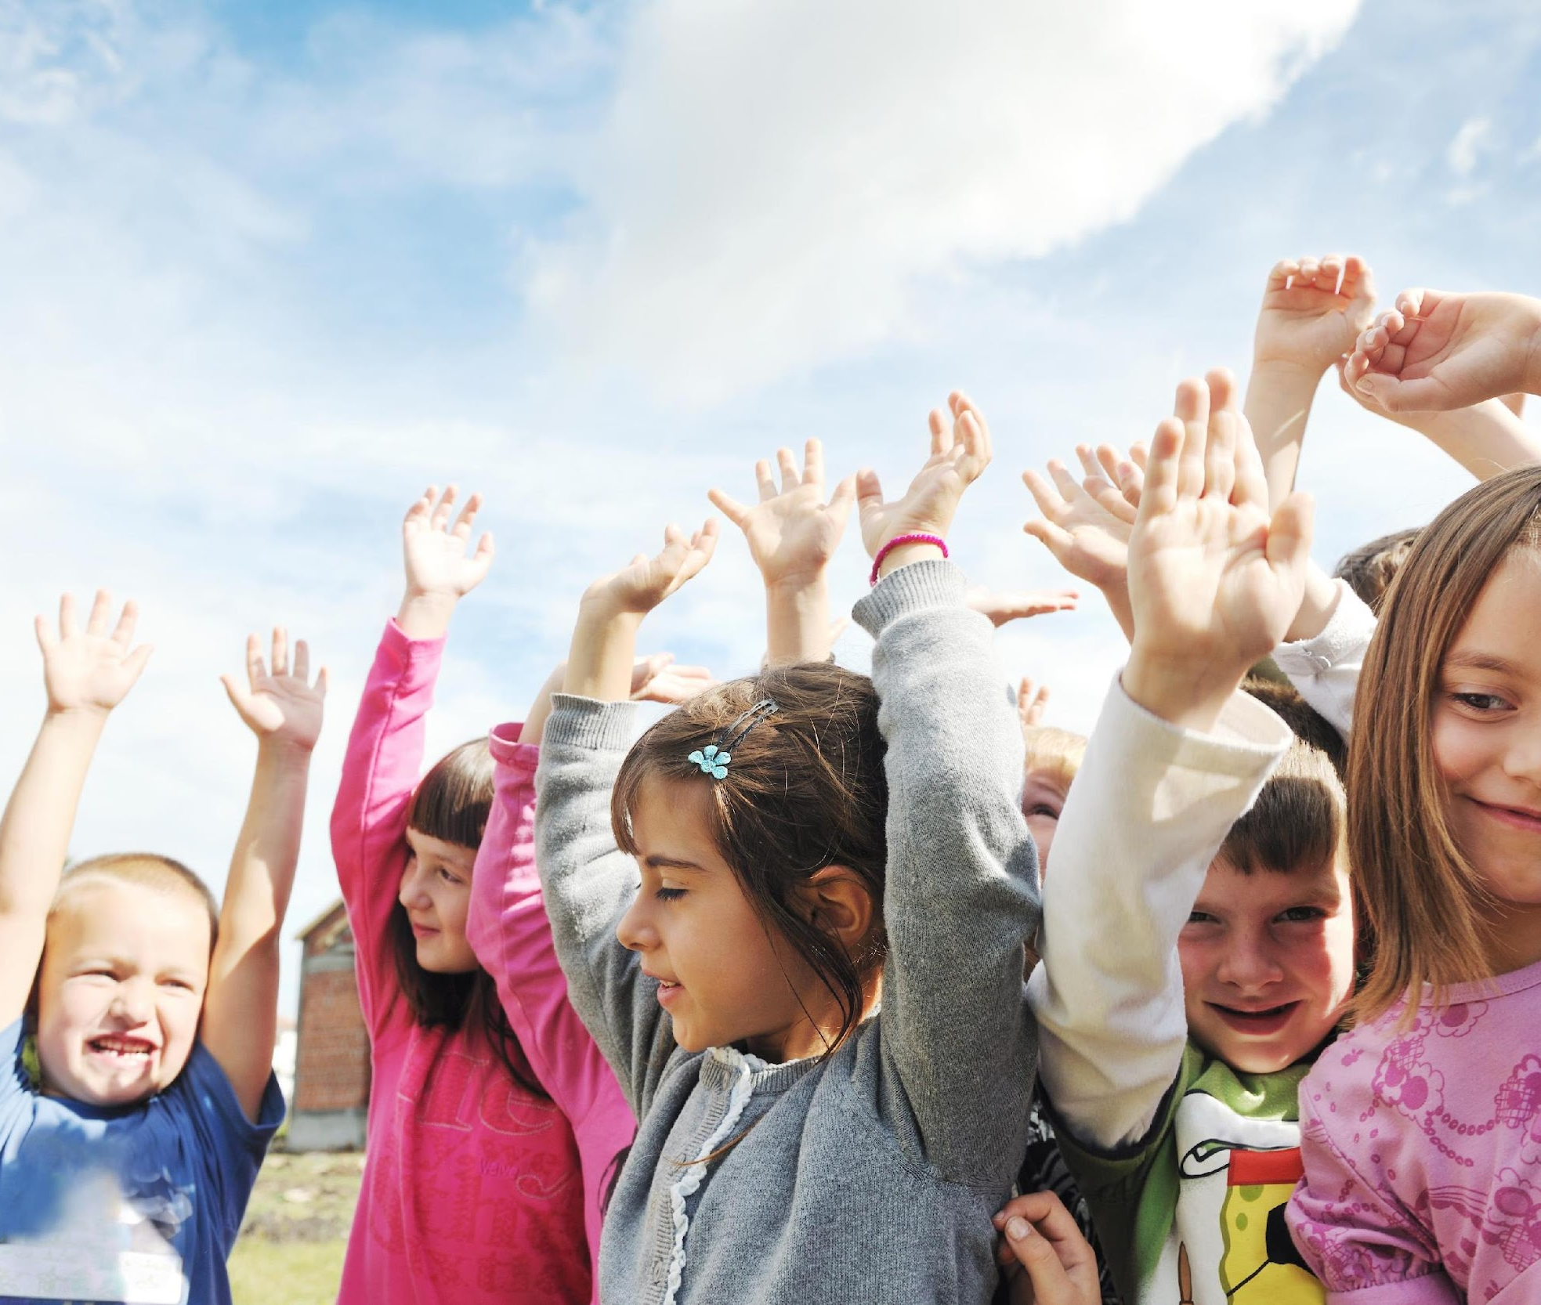
Day 1: Say What?
Say what? This month, we’re going to learn the importance of being respectful when talking to others about their health. Health is different for everyone including how we move, the foods we eat, and the way we think, and feel.
Since it’s different for everyone, it is important to be respectful of others’ health and how they choose to practice it.

Slide 2
Day 2: Say What?
Part of everyone having different health includes having different physical abilities. It’s important to know that what you can do is far more important than how you look. So take a minute to think of something cool you can do.
Can you run really fast? Can you throw a baseball super far? Can you jump high like a kangaroo? Share this cool ability with the person sitting next to you and see what they can do too!

Slide 3
Day 3: Say What?
When you’re playing in gym class or recess and you see someone who is having a hard time with the activity, go over and offer to help them. You can help by showing them proper form, or provide words of encouragement like, “Keep trying, you’ll get it” or “practice makes progress”.
These kind words will motivate them to keep participating in gym class, recess, other sports and keep them healthy!

Slide 4
Day 4: Say What?
If you’re playing a game during recess, make sure to include everyone who wants to play; they might surprise you with a unique skill that can make the game more exciting to play!
Next time someone asks to play with you, instead of saying no, be excited and ask them what they are good at. Let them play a role that will show you their talent!

Slide 5
Day 5: Say What?
What do you call it when a dinosaur scores a goal in hockey? A dino-score! Everyone can score during a game and it’s important to cheer on all of your teammates when they do.
Say things like, “that goal was so good!” or “wow, you played really well” to encourage your teammates when they do well.

Slide 6
Day 6: Say What?
Another part of enjoying sports and movement is being proud of what you can do and thinking or speaking kind words about yourself. If you’re playing hide and seek or tag and you don’t win but you were giving it 110%, don’t beat yourself up for it. That doesn’t make physical activity very fun.
Instead, be proud of showing up and tell yourself you will have another chance to win the next time you play.

Slide 7
Day 7: Say What?
A big part of having good health is having good body image. That means being proud of your body and appreciating it for everything it can do. Did you know that your body does a lot of things for you like using energy from food to help you grow? And absorbing oxygen to help you think? Computers and robots can’t even do that!
Can you think of other things your body can do that even a robot can’t? Share it with the class and be proud of how cool your body is!

Slide 8
Day 8: Say What?
Everyone’s bodies are unique, meaning that they are all completely different. This is because your body has grown in the way it needed in order to take care of you. What do you think is unique and interesting about your body?
Maybe you're tall and you can reach things that are high up, maybe you're shorter and you are really good at getting down to limbo, maybe you have cute freckles, or you have curly hair that bounces when you run. What other things can you think of that are unique and awesome about your body? Are there qualities about your peers that you admire?

Slide 9
Day 9: Say What?
Your body is growing a lot and doing so many things to keep you healthy. But everybody needs different things to be healthy. That’s why your body might look different from your friend’s body. It’s just like when a banana looks different from an apple. It’s important to remember that your body is unique and that your friends will also have unique bodies.
Instead of expecting everyone to look the same, remind yourself they are special, and their body is working hard to take care of them. Celebrate all bodies exactly how they are!

Slide 10
Day 10: Say What?
It’s important to have a good body image but it is also important for you to be kind to others about their bodies. Before you comment on someone else’s body or appearance, THINK.
Is it helpful? Is it inspiring? Is it necessary? And is it kind? If not, it's best not to share that comment.

Slide 11
Day 11: Say What?
Remember, having a good body image is about feeling proud of your body and appreciating it for what it does because that helps you feel more confident about yourself.
Make sure you talk about your body nicely by saying things like, “my body is so strong for being able to walk to school every day” or “my body is a powerhouse because it can do things like lift heavy boxes.”

Slide 12
Day 12: Say What?
Another part of health includes mental wellness. This includes your emotional well-being which affects how you think and feel.
Saying mean things to others can affect their mental wellness and make them sad or angry, so it is important that you say nice things to others like, “you’re so smart for figuring out that math question” or “it’s impressive that you can swim so fast.”

Slide 13
Day 13: Say What?
If you see a friend, sibling, parent, or anyone else having a bad day, instead of saying “you shouldn’t feel that way” or “just get over it,” try asking them if they want to talk about how they feel. This will let them know that it’s okay to have bad days and that they are allowed to feel upset.
By asking them if they want to talk, you are showing that you care for them and want to support them.

Slide 14
Day 14: Say What?
If you are having a bad day, remember that everyone has bad days sometimes. That means that your friends, parents, teachers or coaches can probably relate and are able to support you during the bad days.
Next time you are having a bad day, reach out to your friends, parents, teachers, or another trusted adult for help. Let them know you are having a bad day and talk about it. This will help you feel better.

Slide 15
Day 15: Say What?
Part of mental well-being includes having good self-esteem. Self-esteem is how you value and think about yourself. Recognizing and appreciating that you are unique is important to having good self-esteem.
Thinking mean things about yourself can negatively affect your self-esteem. So it is important to be kind and to say nice things when talking to yourself. Let’s practice that! Try saying something nice about yourself out loud.

Slide 16
Day 16: Say What?
Talk to yourself the way you would talk to your friend. You wouldn’t tell your friend they are bad at something or that they should be embarrassed about something, so you shouldn’t tell yourself that either.
Telling yourself encouraging things like, “I am getting better at sports” or “I am a hard-working student” will help you feel excited to continue trying challenging things.

Slide 17
Day 17: Say What?
Another part that affects our health includes the food we eat. This includes how you feel about the food and who you eat it with. By eating foods that you enjoy and that make you feel good, your body is more likely to grow and stay healthy.
Eating food with others helps you enjoy mealtimes because you are spending time with people and building your relationships with them.

Slide 18
Day 18: Say What?
People from all over the world have moved to Canada and brought their tasty foods with them. Just because we don’t recognize a food someone else is eating doesn’t mean it isn’t yummy and nutritious.
Instead of saying someone’s food is gross because you don’t recognize it, try asking them what they’re eating and learn about it. You might end up thinking it sounds pretty delicious!

Slide 19
Day 19: Say What?
Did you know that eating well is important for health? Without food, you wouldn’t have the energy to paint a picture, do your schoolwork, or play games!
It is important to make sure you eat when you’re hungry because your body is saying it needs more energy and there’s nothing wrong with needing an extra snack or meal. When you see others eating, don’t compare them to yourself by saying, “I don’t eat that much” or “that’s not a lot of food” because their body needs different amounts of energy than yours and that’s okay.

Slide 20
Day 20: Say What?
Part of enjoying your food includes eating with others. It allows you to build friendships, learn about other cultures, and learn about foods you might not be familiar with.
Try eating with new friends in the cafeteria and get curious about what yummy foods they brought to school. Ask them what they enjoy about their food. Is it the texture? The flavour? The smell? How it looks? Or that they get to eat with their family every day?

Slide 21
Day 21: Say What?
What do you call an angry pea? Grump-pea! Did you know that listening to your body when it feels full is just as important as fueling it up when it says it’s hungry?
If you have more food in your lunch box but your belly feels full and satisfied, tell yourself that it’s okay to not finish everything. Remember, you can still eat it later when you’re hungry and your belly tells you it needs more energy.

Slide 22
Day 22: Say What?
Say what? It’s already been a whole month! This month we learned how to talk positively about health.
Remember that your health is unique to you! We hope that you continue to spread positive messages about health with everyone around you!

