Slide 1
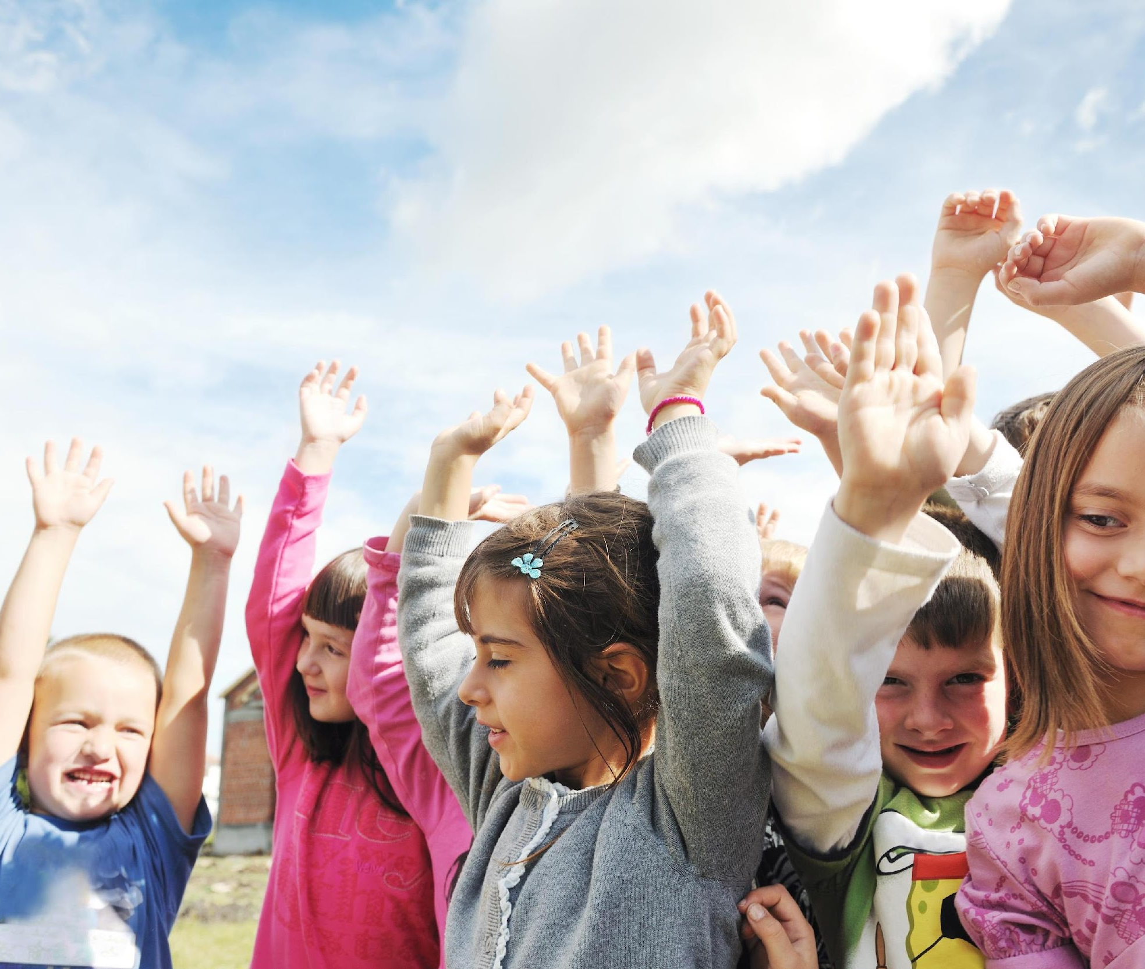
Day 1: The Way iMove to School
This month we are going to learn all about active transportation and all the fun ways we can use our feet to get to and from school. Active transportation means that we are choosing to get to school by walking, cycling, inline skating, or driving part way to school and then walking the rest of the way.
Get ready to listen in on all the ways that we can use our bodies to get to school!

Slide 2
Day 2: The Way iMove to School
Do you know that October is International Walk to School Month? Instead of getting a ride to school, this is a great time to start walking. You can walk five, four, three, or two days a week. Even one day a week is a good start.
If you already walk to school, congratulations! You know that walking is fun, good for you, and good for the earth!

Slide 3
Day 3: The Way iMove to School
Did you know that children aged 5-11 need an hour of physical activity in a day? Walking to and from school is a great way to get some physical activity into your day. If you cannot walk to school you could try walking around the school and playground to get your body and brain ready for learning before the school bell rings. To get some steps in let’s do an activity. Stand up and push in your chairs.
Let’s walk around the classroom one time to wake up our brain and body... I will count to 10 to give you enough time to get back to your desks…Ready? Go! Great job you are well on your way to being an active commuter!

Slide 4
Day 4: The Way iMove to School
Cycling, inline skating, skateboarding, & scooting are all great ways to wheel to school! Make sure to always wear a properly fitted helmet when cycling and when doing other wheeling activities it is important to protect other body parts with elbow pads and kneepads.
Be sure that your bike is safe too! Always lock your bike to a bike rack and be sure to take care of that bike lock key! Raise your hand to show your teacher if you were an active commuter today and used your body and feet to get to school.

Slide 5
Day 5: The Way iMove to School
Don’t let the changing weather stop you from being an active commuter. As the weather starts to get a little cooler in the mornings be sure to wear layers of clothing to keep you warm. As you walk your body will begin to warm up and you will enjoy the crisp fall air that you are breathing in.
Raise your hand to show your teacher if you were an active commuter this week and used your body and feet to get to school.

Slide 6
Day 6: The Way iMove to School
What are some of the ways you move to school? Come and tell (insert teacher or facilitator name here) _________ today and show them that you are interested in becoming or continuing to be an active commuter.

Slide 7
Day 7: The Way iMove to School
Your body was designed to move! Did you know choosing to use your feet to get to school will get your brain & body ready to learn? By doing active transportation you are waking up your senses by breathing in the fresh air and preparing yourself for a full day of learning.
Plus it is one of the easiest ways to make sure you get some physical activity into your daily routine. I look forward to seeing you being an active commuter this week!

Slide 8
Day 8: The Way iMove to School
Ever stop to hear the birds or feel the rustle of wind through your hair? There is so much to see and explore within the environment when you are doing active transportation. Active transportation reduces air pollution and increases the air quality within your neighborhood.
Next time you are using your feet to get to school take some time to enjoy the environment.

Slide 9
Day 9: The Way iMove to School
Did you know that distances travelled up to 5 kilometers are traveled more quickly door-to-door by bicycle than by car? Doing active transportation can be convenient and fun! Next time you walk or cycle to school time yourself to see how long it takes you.
Can you beat your time the next day? What a fun way to get some exercise and help the environment!

Slide 10
Day 10: The Way iMove to School
Did you time yourself this morning on how long it took you to get to school? Active transportation can give you an opportunity to hang out with your friends more. Having a buddy to walk or cycle is a great way to stay motivated to continue to do active transportation. A buddy can also make the time go by faster as you use your feet and bodies to get to school!
Are you an active commuter?

Slide 11
Day 11: The Way iMove to School
Raise your hand if you did any active commuting to the store or to a friend’s house this weekend? Did you know that you don’t only have to be an active commuter at school you can do errands by walking, riding your bike and even taking the bus allows you to walk from the bus stop so you are getting some steps in!
Next time you are going to a store that is close by ask your mom and dad if you can get there by using your bodies and feet!

Slide 12
Day 12: The Way iMove to School
Active transportation can be a bit challenging if you do not know how to get from your house to the school. Creating a safe route to school map with your teachers or with a parent is a great way to understand your community and the best way to get to and from school safely! Create a couple different safe routes so that you can add some variety in how you move to school such as a cycle route and a walking route.
Were you an active commuter today?

Slide 13
Day 13: The Way iMove to School
How is being an active commuter going for you? Do you feel like there’s never enough time in the morning to walk? Don’t worry, to help make the morning easier, do some of these things before you go to bed: Make your lunch, Take your shower, Check the weather report, Lay out your clothes, Pack your backpack
Getting these things done at night will free up time in the morning so you can be an active commuter. Remember, using your body and feet is a fun way to get to school. It is good for you, and good for the earth.

Slide 14
Day 14: The Way iMove to School
It’s raining, it’s pouring … but you can still do some walking. Walking is fun, good for you, and good for the earth even in rainy weather. You just need to:
Carry an umbrella, Wear a raincoat and waterproof shoes or boots, Put an extra pair of socks in your backpack, so wet socks can be changed
Are you an active commuter?

Slide 15
Day 15: The Way iMove to School
Eating healthy is important for keeping our bodies growing strong. Are you choosing a healthy breakfast before you head out to the door to start your active commute? Choosing healthy breakfast that contains at least 3 out of the 4 food groups will give you the energy you need to get to to school and be ready to learn.
Check the school’s newsletter this month for a healthy breakfast that you can try. This will give you the energy you need to move your feet and body to school!

Slide 16
Day 16: The Way iMove to School
We are talking about being a safe active commuter to and from school. To help you remember there are 5 Safety “Bee’s” that you should know in order to get to and from school safely. Are you ready to learn them? The first one is “Bee Safe & Take Responsibility” this means to: Travel with a parent or buddy, Cross only at crosswalks or corners, Don’t run out from between parked cars, Lock your bike and store your ride safely at school.
If you think you can remember the first “Bee” to being a safe commuter make a buzzing sound and give the person closest to you a high five! You are well on your way to being a safe active commuter.

Slide 17
Day 17: The Way iMove to School
The second “Bee” is to “Bee an Example: Model safe behaviours every time” this means to: Not jaywalk. This means not crossing the street where there is no crosswalk. Not cross the street at major intersections until the light has changed red and you see a white walking sign indicating that it is safe to cross the street. Obey the school patrollers and be sure to listen to them for your safety.
Remember that bees work together so you and your friends can remind each other to be safe as you travel to and from school using your bodies and feet! Keep on buzzing!

Slide 18
Day 18: The Way iMove to School
The third “Bee” safety tip is, “Bee Seen: Make yourself visible to other road users” this means to: Wear bright or reflective clothing, Stay on pathways- don’t cut through parking lots or lanes, Use lights and reflectors on your bike and backpack, Make eye contact with drivers and make sure all cars are stopped before crossing the street.
Do you remember the other two safety “Bee tips”? Come and tell (insert teacher or facilitator name here) _________ today and show them that you are interested in bee-coming or continuing to be a safe active commuter.

Slide 19
Day 19: The Way iMove to School
I am sure glad you have been practicing being safe active commuters. Today we learn about the fourth “Bee” safety tip “Bee Smart: Know the rules and risks!” this means to: Learn and follow the rules of the road, Dress for the weather, Wear your helmet and safety gear, Walk your bike/carry your skateboard at street crossings.
It is very important to protect yourself while you are an active commuter so that you can continue to buzz to and from school by using your body and feet!

Slide 20
Day 20: The Way iMove to School
The last safety tip is to “Bee Sure: Bee aware of your surroundings!” this means to: Stop at the curb, look all ways and listen for oncoming traffic. Point, pause and proceed when crossing the street. Texting, listening to music or talking on the phone are all distractions make sure you are paying attention before crossing the street.
Congratulations on learning the 5 “Bee’s” to being a safe active commuter. To remind us to always bee safe I am going to count to 5 and you are going do your best bee impression and fly around your desk in a safely 5 times. Are you ready! Go! Great job safe active commuters!

Slide 21
Day 21: The Way iMove to School
You might find yourself a little hungry after school on your active commute home. Instead of stopping at a convenience store and getting a bag of chips or a chocolate bar think about packing an extra snack to eat on your way home.
A piece of fruit and some yogurt or crackers and cheese are great snacks to choose as they have two food groups in them and will give you the energy you need to get home!

Slide 22
Day 22: The Way iMove to School
Great job this month on being active commuters! I look forward to seeing you continue to walk or wheel to school in the upcoming months. Remember to bee safe and follow the 5 “Bee” safety tips and enjoy the benefits of using your body and feet to actively commute to school!

