Slide 1
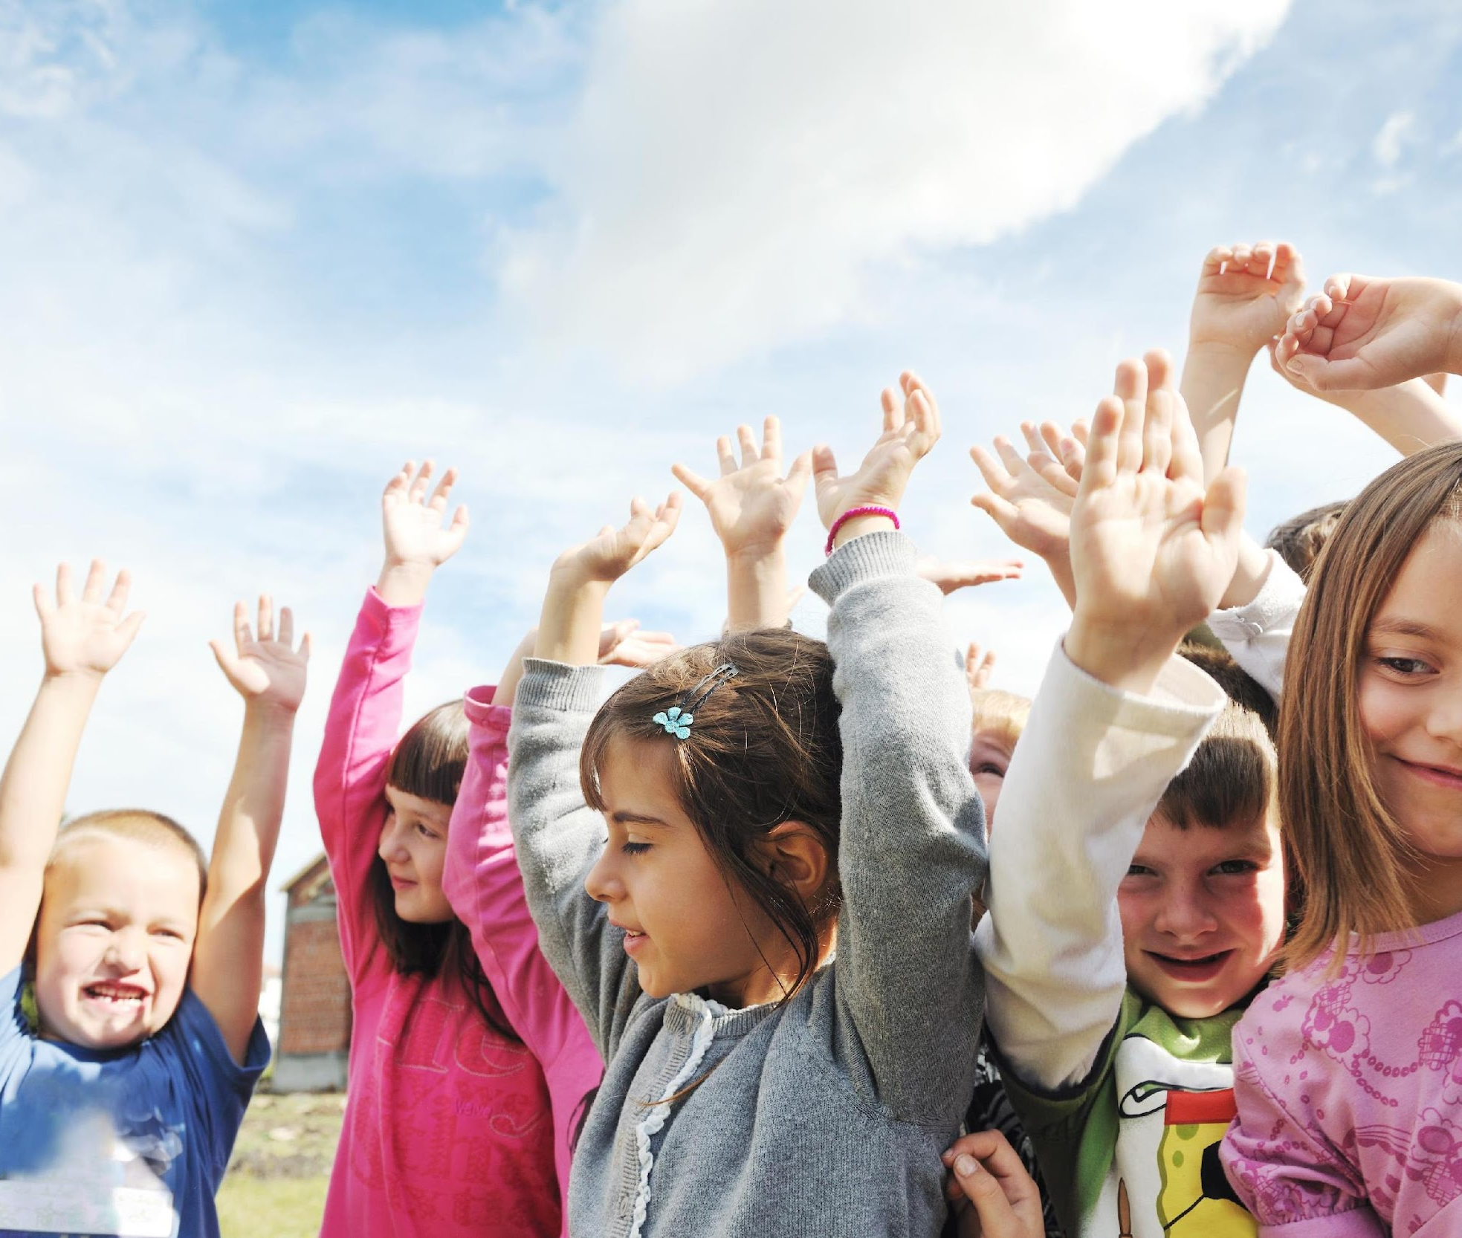
Day 1: Way to Go, H2O
This month, we will be talking all about H2O, with the monthly campaign Way to Go H2O! Do you know what H2O stands for? It’s the scientific formula for water!
Starting tomorrow we will learn all kinds of facts about water and how it helps your body stay healthy. Way to Go, H2O!

Slide 2
Day 2: Way to Go, H2O
Did you know that your body is made up of 60% water? Drinking enough water maintains your body’s fluid balance, keeps your body temperature where it needs to be, and helps you digest your food!!
Make sure that you stop to drink some water today.

Slide 3
Day 3: Way to Go, H2O
Did you know that your muscles need water to work properly?
Water and something called electrolytes work together in your body to keep your muscles running in tip-top shape. When you exercise, it is important to drink water so that it keeps your muscles healthy.

Slide 4
Day 4: Way to Go, H2O
What are the ways that our bodies can get enough fluid? We can get the appropriate amount of fluid through drinking water, milk, and other healthy fluids. You can also get healthy fluids through eating fruits and vegetables because they contain a lot of water.
Having a healthy snack of a fruit or vegetable will help keep you hydrated.

Slide 5
Day 5: Way to Go, H2O
Drinking water regularly is a good habit to develop. You can start this weekend!
While you’re at home, set a timer for every hour to remind you to have a drink of water. You can ask your whole family to develop a healthy habit and drink water with you!

Slide 6
Day 6: Way to Go, H2O
Today you’re going to learn some fun facts about your body:
Your brain is made up of 90% water, your blood is 83% water, your muscles are 75% water, and your bones are 22% water. That’s a lot of water!

Slide 7
Day 7: Way to Go, H2O
Do you get hungry and feel a snack attack coming on? Close the refrigerator or cupboard, and grab a glass of water instead. Sometimes when you’re hungry, you might just be dehydrated and need a drink.
Next time you want to munch on something, grab a drink of water instead and then decide if you are still hungry.

Slide 8
Day 8: Way to Go, H2O
Tired of drinking plain water? Time to change things up!
A quick way to do this is to add fruit to your water. You can cut up choose-most-often foods like oranges, lemons, limes, strawberries, or mint and add them to your water for a refreshing change. Try it at home with your families.

Slide 9
Day 9: Way to Go, H2O
Here is an interesting fact about water.
The average person could live without food for nearly a month, but could only survive about a week without water -- that’s how important water is to human life.

Slide 10
Day 10: Way to Go, H2O
Yesterday we learned that a human can only survive one week without water.
To learn more interesting facts about water, check out the Way to Go H20 bulletin board located (mention the location).

Slide 11
Day 11: Way to Go, H2O
Our skin is the largest organ in our body. Water helps keep our skin healthy.
Drinking enough water in a day prevents it from drying out, helps keep pimples away, and gives your skin a healthy glow.

Slide 12
Day 12: Way to Go, H2O
How much water is enough water?
It is recommended that Kindergarten to Grade 3 students need 6 glasses and Grade 4 to 8 need 7 glasses of water a day to stay healthy. If you are exercising, running around, or it is hot outside, you will need more water to keep you going because you sweat it out.
Are you getting enough water?

Slide 13
Day 13: Way to Go, H2O
No matter where you are in the world it is important to drink water. Canada is considered a water-rich country, and has approximately 20% of the world’s freshwater.
Don’t forget to check out the bulletin board (insert bulletin board location) to inspire you to drink some water today!

Slide 14
Day 14: Way to Go, H2O
Keeping a water bottle near you will help you drink more water.
Keep a water bottle with you on your desk at school, put one on your bedside table in case you need a drink in the night, and keep one in your school bag or extracurricular bag. Take one with you wherever you go so you never get thirsty.

Slide 15
Day 15: Way to Go, H2O
Here is a healthy habit for you to try.
Try to drink a glass of water before each meal. This will keep you hydrated, and help your body know how hungry you really are because you won’t be dehydrated before you start eating. Try it today when you’re eating your lunch.

Slide 16
Day 16: Way to Go, H2O
Water can occur in all three forms of matter – solid, liquid, and gas! It’s a solid as snow or ice, it’s a liquid as water, and it’s a gas as steam when water boils!

Slide 17
Day 17: Way to Go, H2O
When it’s really hot outside, your body sweats. When you sweat, your body loses water. It’s important to drink lots of water on hot days to replace the water that your body sweats out.

Slide 18
Day 18: Way to Go, H2O
Animals need water to stay healthy too. A frog absorbs water through its skin, while some monkeys will use leaves to make a cup to drink water. A camel can drink up to 570 cups of water a day and an elephant can drink up to 845 cups a day!

Slide 19
Day 19: Way to Go, H2O
Do you feel tired in the afternoon? This could be because your brain is a little dehydrated. Drinking water when you feel this way will help you feel better. After lunch when you are feeling tired, grab your water bottle and have a drink. It will help you feel alert and ready to learn.

Slide 20
Day 20: Way to Go, H2O
Have you ever had a really bad headache? Next time you do, drink a few glasses of water. If you don’t drink enough water you can get dehydrated which may cause your headache. See if drinking water will help you feel better the next time you have one.

Slide 21
Day 21: Way to Go, H2O
There are lots of fruits and vegetables that contain water. Watermelon, cucumber, celery, strawberries, and tomatoes are made of 90% water or more! Next time you’re thirsty, think about having one of these choose-most-often snacks.

Slide 22
Day 22: Way to Go, H2O
What a great month it has been learning about the importance of drinking water. I hope that you have been drinking water regularly and have developed a healthy water drinking habit.

